Slide 1
On the Perception of Small Subgraphs
Jacob Miller,
Mohammad Ghoniem,
Hsiang-Yun Wu,
Helen Purchase

Slide 2
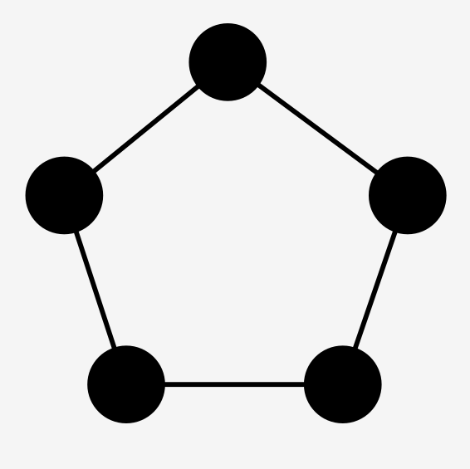

Slide 3
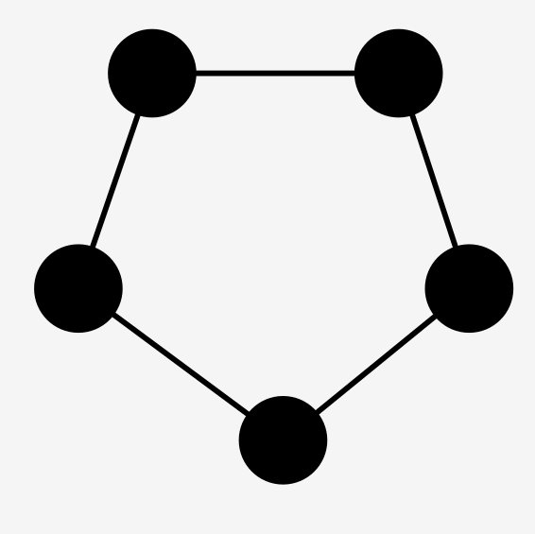
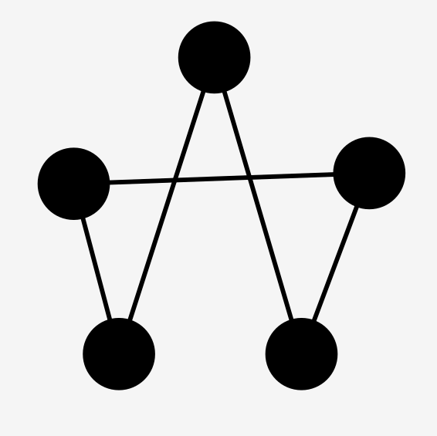
Which of these are more similar?

Slide 4
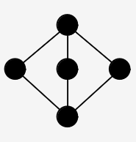
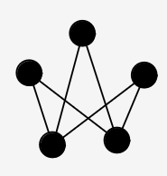
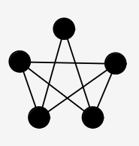
Which of these are more similar?
?

Slide 5
Which of these are more similar?
Same Structure, different shape
Different structure, same shape

Slide 6
Hypotheses
Judge to be different
Judge to be the same

Slide 7
Three levels of perceptual processing (Ware 2021)
‘Bottom-up’: low-level properties
‘Pattern recognition’: grouping into regions, patterns
‘Top-down’: Cognitive evaluation

Slide 8
Three levels of perceptual processing (Ware 2021)
‘Bottom-up’: low-level properties
‘Pattern recognition’: grouping into regions, patterns
‘Top-down’: Cognitive evaluation

Slide 9
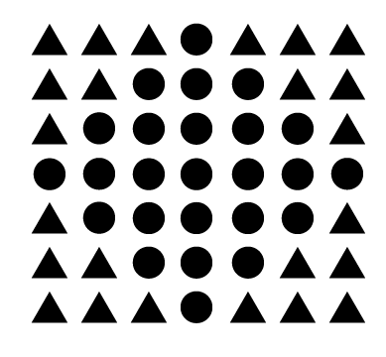
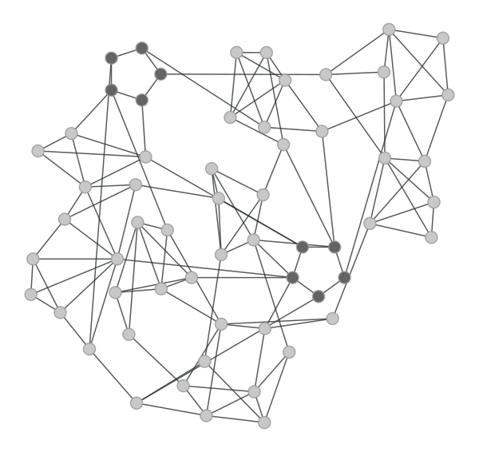
Gestalt Principle of Similarity
Source: Creative Beacon
Distinct objects may be grouped together by looking similar
During pattern recognition, subgraphs may be grouped together by looking similar

Slide 10
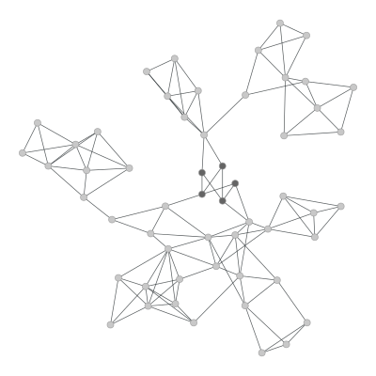
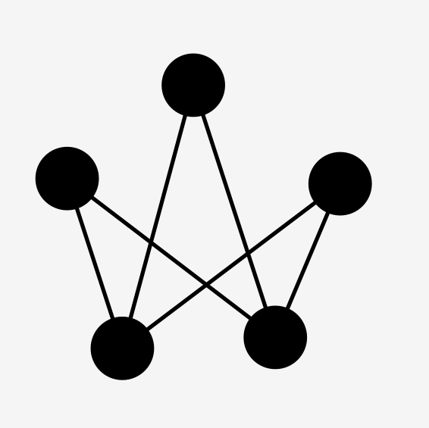
Graph motifs
Subgraph, together with a drawing
Motif of

Slide 11
Experimental design: Overview
Define “base” motifs
Plant variations of motifs into graphs
Experiment 2
Compare base motif to force-directed-modified motif
Experiment 1
Compare base motif to modified motifs
Modify by
Structure
Shape
Both

Slide 12
Experimental Design: Motifs
5 interesting and identifiable motifs
Bi-clique
Clique
Cycle
Double-cycle
Star

Slide 13
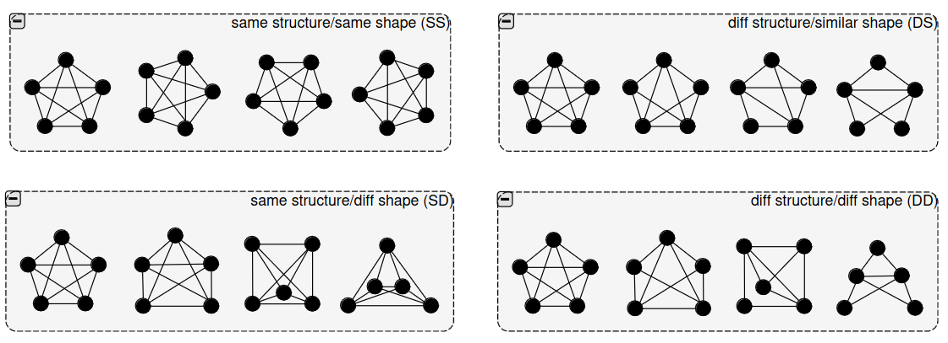
Experimental Design: Motif Variations
2-dimension variations
Structure
Shape
GED: Graph Edit Distance
GED = 1
GED = 2
GED = 3
Notes:
Add GED here; number of nodes is fixed.

Slide 14
Experimental Design: Generating Layouts
Generate random graph
Graph
|V|=50; |E|~100

Slide 15
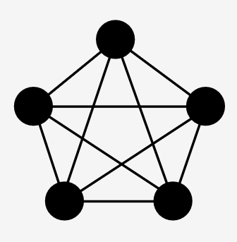
Experimental Design: Generating Layouts
Generate random graph
Stitch motif into graph
Graph
|V|=55; |E|~100

Slide 16
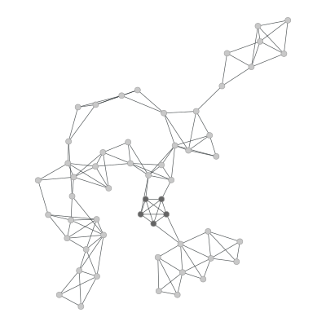
Experimental Design: Generating Layouts
Generate random graph
Stitch motif into graph
Layout graph by constrained MDS

Slide 17
Experimental Design: Generating Layouts
Generate random graph
Stitch motif into graph
Layout by constrained MDS
Edit graph/layout to satisfy constraints

Slide 18
Experimental procedure
Crowd-sourced
Used Prolific+Qualtrics
5 sets of experiments, 1 for each motif
30 valid participants each, around 10 minutes per participant

Slide 19
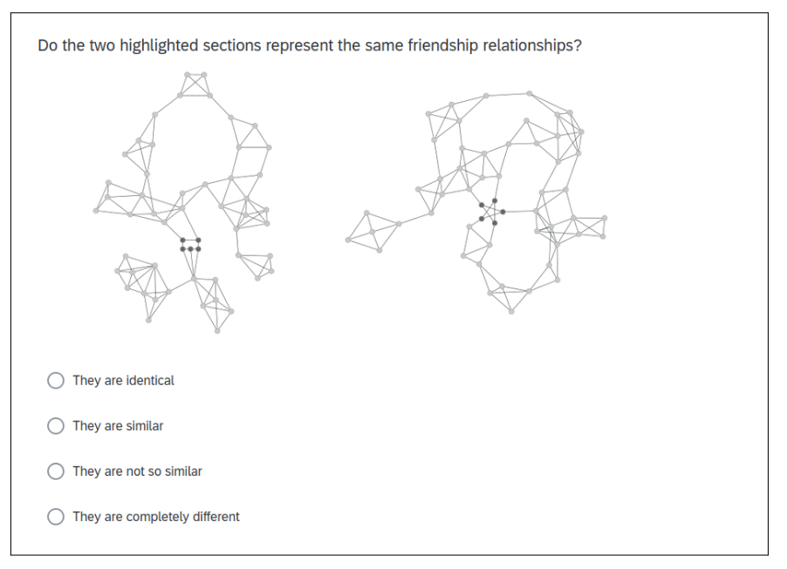
Experimental Design: Procedure
We ask participants to evaluate two graphs with highlighted motifs
One base motif, one modified motif
“Do the two highlighted sections represent the same friendship relationships?”
Participants had 4 seconds to respond

Slide 22
Experimental Design: Dependent Variable
Similarity accuracy
Measured by how ‘correct’ the response was
Graph Edit Distance
Responses

Slide 23
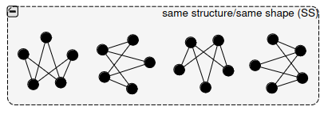
Results: Q1
Does rotation affect the perception of the same sub-graph represented using the same visual form?

Slide 24
Results: Q1
Is there a significant difference in accuracy when comparing the base motif with rotarted variations?
No

Slide 25
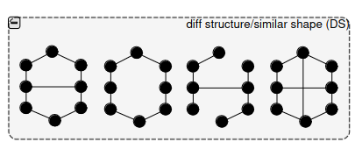
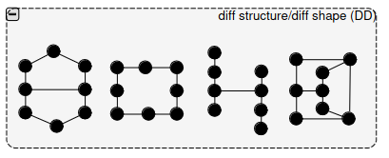
Results: Q2
If the motif is adapted to create a sub-graph of different structure, does depicting it in a similar manner affect the ability to distinguish the difference?

Slide 26
Results: Q2
Is there a significant difference in accuracy between identifying different motifs (compared with the base) with the same or different visual forms?
Yes
Except for double-cycle

Slide 27
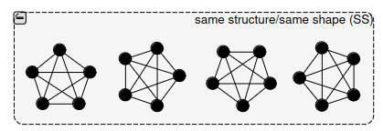
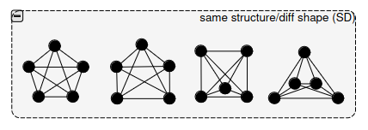
Results: Q3
Does using a different layout affect perception of motifs of the same structure?

Slide 28
Results: Q3
Is there a significant difference in accuracy between identifying identical motifs (compared with the base) with the same or different visual forms?
Yes

Slide 29
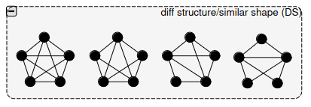
Results: Q4
If different sub-graphs are depicted in similar shape, are near-similar sub-graphs incorrectly assessed as being similar?

Slide 30
Results: Q4
Is there a significant difference when comparing identical motifs (GD=0) versus highly dissimilar motifs (GED=1,2,3).
Yes

Slide 31
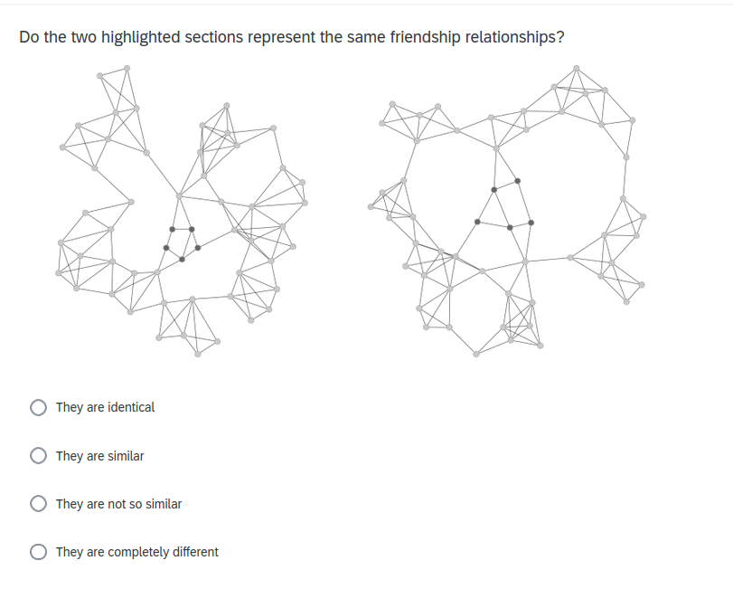
Results: Q5
Is it easier to match identical small motifs if they have both been given a well-formed, regular shape?

Slide 32
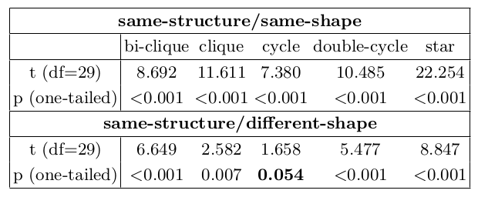
Results: Q5
There is a significant difference in accuracy when identifying well-formed motif structures in comparison with force-directed form

Slide 33
Results: Q5
There is a significant difference in accuracy when identifying modified, yet well-formed motif structures in comparison with force-directed form
Except for cycle

Slide 34
Recommendations
Draw identical subgraphs similarly

Slide 35
Recommendations
Draw dissimilar subgraphs (very) differently

Slide 36
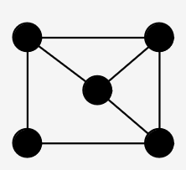
Recommendations
Draw dissimilar subgraphs (very) differently

Slide 37
Future Work
We study 5-8 node motifs; Does this hold for larger structures?

Slide 38
Cluster B
Cluster A
Cluster
C
Cluster D

Slide 39
Future Work
We study 5-8 node motifs; Does this hold for larger structures?
Layout algorithms that identify motifs, and depict them similarly

Slide 40
Acknowledgements
This work arose from collaboration initiated at Dagstuhl Seminar 23051, “Perception in Network Visualization”, February 2023.

Slide 41
Future Work
We study 5-8 node motifs; Does this hold for larger structures?
Layout algorithms that identify motifs, and depict them similarly
Open for questions

Slide 42
Comments and Questions

