Slide 1
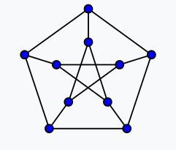
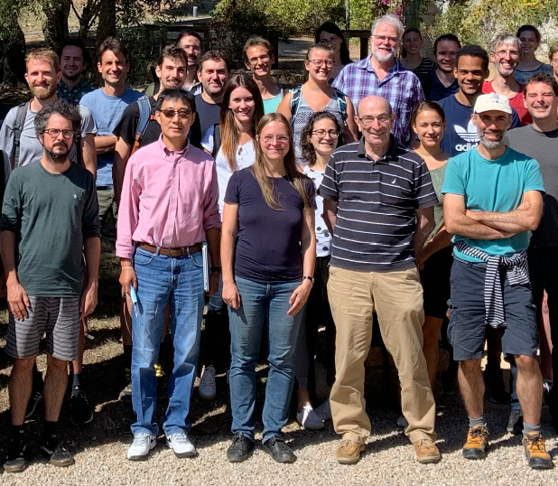
Boxicity and Interval-Orders: Petersen and the complements of Line Graphs András Sebő CNRS, Univ. Grenoble Alpes, Labo G-SCOP joint work with Marco Caoduro Sauder School of Business, Univ. British Columbia
GD2023, September 21
Notes:
I first present some particular boxes. Here we are together in our natural environment of combopt …
Here is Marco in more details, my details are here in 3D
And now we can go to the boxes of the talk.
We are in white boxed and there we are, boxes …killing the punchline …

Slide 2
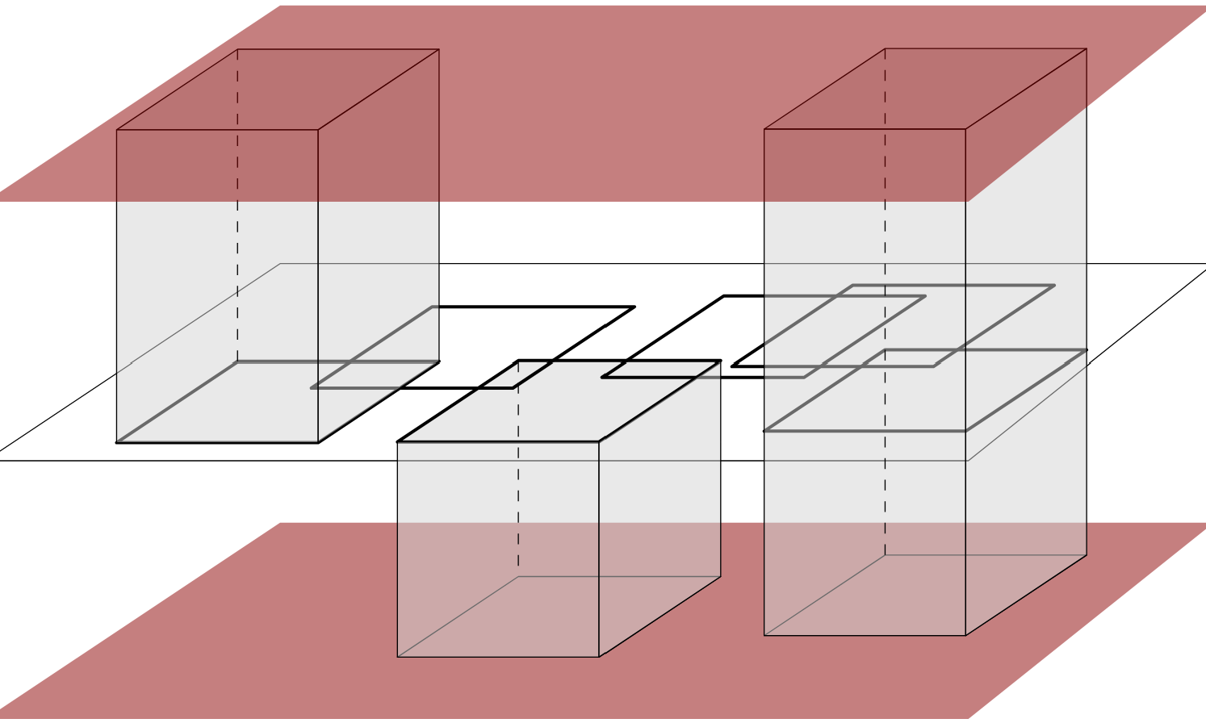
Boxicity and Interval-Orders
Def : An (axis-parallel) box in IR^{d}: I₁ × … × I_{d} ⊆ IR^{d},
I_{j} ⊆ IR are closed intervals (j=1, … ,d).
box(G) := min { d: G is the intersection graph of boxes in IR^{d} }
Vertices: boxes; B₁B₂ is an edge,
if B₁∩B₂ ≠ ∅
< ∞ ? i.e can every graph be represented with boxes ?
Intersection graphs: a way of drawing graphs
box(cycles)=box prism= 2.
Adding two non-adjacent vertices the boxicity increases by at most 1, so
box(G) ≤ ⎣ $\frac{n}{2 }$ ⎦ (Roberts 1969)
Notes:
We can immediately get rid of the first line of the title, it is like starting with the punchline
2. We have only axis-parallel boxes

Slide 3
Boxicity and Interval orders
Easy, algorithmic
box(G) = 1 ⇔ G interval graph ⇔ $\overline{G}$ interval-order graph, that is, ∃ order v₁ , …, v_{n} of V(G) :
if i < j, then N⁺ (v_{i}) ⊇ N⁺ (v_{j}) (Olariu 1991)
box(G)=d ⇔ G intersection of d interval graphs ⇔ $E\left(\overline{G}\right)$can be covered by d interval-order graphs
{v_{t}: v_{i} v_{t} ∈E(G)), t > i }
C₄ = $\overline{2K2}$
NP-hard
⇒ efficient way of generating interval-order subgraphs :
box ( $\overline{2K2}$) = 2
v₃
v₃
v₃
v₃
v₁
v₄
v₁
v₄
v₁
v₄
v₁
v₄
interval-order subgraph from the order v₁ , v_{2 ,} v₃. Not maximal !
G
v₅
v₂
v₅
v₂
v₅
v₂
v₅
v₂
v₃
v₃
v₃
v₃
v₁
v₄
v₁
v₄
v₁
v₄
v₁
v₄
The order v₅ , v₃ , v₁ , v₂ leads to G.
v₅
v₅
v₂
v₅
v₂
v₂
v₅
v₂
Notes:
Easy, but important for us and the algorithm is also linear, easy
Reformulation can be used both for lower and upper bounds …

Slide 4
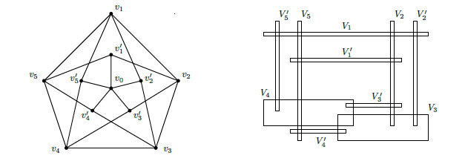
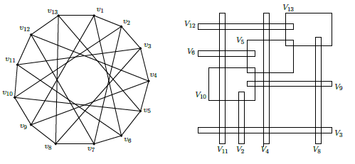
Examples: Petersen, Grötzsch, Ramsey
Cozzen,Roberts 1983: box($C_{n})=2$; box($\overline{C_{n}}$) = ⎣ $\frac{n}{3 }$⎦. Proof. ≥: any 4 edges contain $\overline{C_{4}}$; ≤ cover $C_{n}$by $P_{4 }$-s
v₁
v₆
$$C_{n}$$
v₆
box (Petersen) = ?
v₅
v₂
v₁₀
v₇
v₉
v₈
v₂
v₅
box (Grötzsch ) = ?
v₇
v₉
v₈
v₁₀
v₄
box (RG (3,5) ) = ?
= 3 for all
v₄
v₃
v₃
Petersen graph
Grötzsch
box(Grötzsch-v₀)= 2
Ramsey RG(3,5)
box(RG(3,5) –{v₁, v₇)=2
Notes:
It is already hard for small graphs …

Slide 5
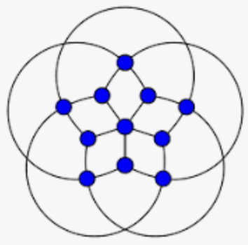
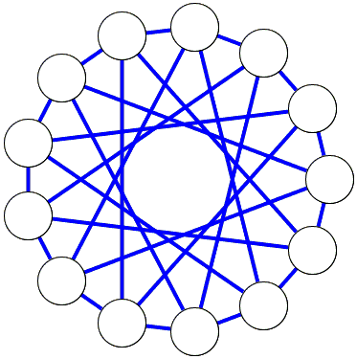
Why do we want to know boxicities of small graphs ? Packing, Covering, Coloring, (and of course for graph-drawing by geometric representation)
υ=1 ⇒ τ=1
υ=2 , τ=3
For any set R of axis-parallel rectangles
max pairwise intersecting set
Wegner’s conjecture (1965): ( υ (R) ≤ ) τ (R) ≤ 2υ(R) - 1
Coloring conjecture : (ω ≤ ) χ ≤ 3 ω
τ (R) := min { |T| : T is a hitting set for R, i.e. |T∩ S | ≥ 1 for all R∈ R }
υ := max { | S | : S⊆R is family of pairwise disjoint sets in R}
coloring: adajacent vertices get different colors
chromatic number χ(G) : min n. of colors of a coloring
Equivalent: χ ($\overline{G}$ ) ≥ 2 ω ($\overline{G}$ ) ⇒ box(G) ≥ 3
χ (G) > 3ω (G) ⇒ box(G) ≥ 3
…
Gaps, chi-boundedness and boxicity:
- Boxicity= 2 would provide counterexamples or tight examples
- Proven cases of Wegner provide bounds on the boxicity
Grötzsch
Ramsey G(3,5)
Notes:
Clearly a graph drawing problem ;=).
- To the last sentence: when the red inequalities are satisfied
The gap of Grötzsch and Ramsey made them a good candidate for a counterexample to Wegner’s, now we start of our main subject for today, a general class of graphs containing the third example we mentioned: Petersen

Slide 6
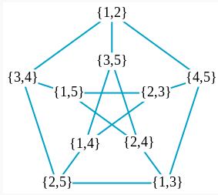
Kneser-graphs and Petersen
Intersection-graphs L (H) of hypergraphs H : join hyperedges that meet.
Kneser- graphs $\overline{L}$(H) of hypergraphs : join disjoint hyperedges
Kneser graphs KG(n,k) := $\overline{L}$(H) , where H is the set of all k-tuples of {1,…, n}
Special case of 2-uniform hypergraphs: line graph L (G ) of a graph G , and $\overline{L}$(G)
→ topology: χ(KG(n,k))≥ n-2k+2 if n ≥ 2k (Kneser, 1955, Lovász 1978)
Stehlík : Boxicity of Kneser graphs ?
First results by Caoduro, Lichev (2021),who conjectured:
Thm 1: If n ≥ 5, box ( KG(n,2) ) = n – 2, in particular box ( Petersen ) = 3.
Petersen =
= $\overline{L} ($K₅)=KG(5,2)
Notes:
We can immediately get rid of the first line of the title

Slide 7
Proof
Key Lemma: Polynomial algorithm for listing all inclusionwise maximal interval-order subgraphs
of line graphs, i. .e. all “interval-disjointness subgraphs” of “edge-non-disjointness graphs” ;
Proof : At most 5 vertices of G uniquely determine an interval-order subgraph, so there are at most n⁵ of these.
box(G) = d ⇔ $E\left(\overline{G}\right)$can be covered by d interval-order graphs
Opens the way for a range of related optimization problems, eg :
NP-hard in general
Corollary : Maximum weight and “any side-constrained” interval order subgraph can be found in polynomial time for line graphs

Slide 8
Main Results
The Lemma, developped through the proof of Thm 1, easily implies the following :
Thm 2: Polynomial algorithm for deciding boxicity ≤ k for complements of line graphs, for fixed k.
Def : Given a graph G, an interval-completion (IGC) of G is
an interval-graph containing G as a subgraph.
NP-hard in general
Thm 3: Minimum weight and “any constrained” IGC can be found in polynomial time for complements of line graphs
Proof: Corollary of the Key Lemma, complemented.

Slide 9
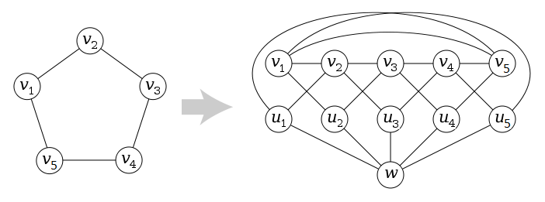
Problems
By Thm 2 in XP
1. Computational complexity of the boxicity for complements of line graphs ? In P ? Or FPT ?
2. The same for line graphs ? P ? FPT ? XP ?
3. For line graphs : Is the boxixity 2 ?
4. For k≥3, box (KG (n, k) ) = ? n -2 ? n-k ? Or χ(KG(n,k)) ?
By Thm 2 polynomial time for
complements of line graphs, for graphs
in general NP-hard (Kratochvíl, 1994)
= n-2 if k=2 by Thm 1
=n-2k+2 if n ≥ 2k (Lovász 1978)
5. Is the boxicity of all Mycielski graphs of cycles = 3 ? (Trial : Kamibeppu’s manuscript )
Mycielski :
M(G)
G
=
Grötzsch
Thanks for having listened, and in advance for asking, answering, commenting, solving … !

