Slide 1
TimeLighting: Guidance-enhanced Exploration of 2D Projections of Temporal Graphs
Velitchko Filipov¹, Davide Ceneda¹, Daniel Archambault², and Alessio Arleo¹
¹ TU Wien, Austria | ² Newcastle University, UK
Notes:
Hello, my name is Velitchko Filipov and I will present our paper called TimeLighting: Guidance-enhanced Exploration of 2D projections of temporal graphs

Slide 2
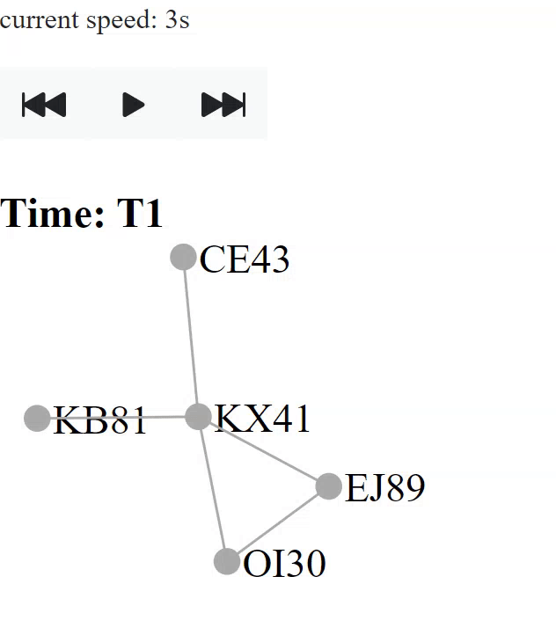
Timesliced Network Visualization
Time axis is discretized
Juxtaposition (JP)
Animation (AN)
Notes:
In traditional dynamic network visualization time is discretized - or time sliced.
Common ways to visualize such networks are juxtaposition (small multiples), where each of the time slices has its own dedicated display space and are arranged typically in a side-by-side manner.
Another approach is to use animation, where the change of the network over time is depicted as smooth transitions between the subsequent time slices.

Slide 3
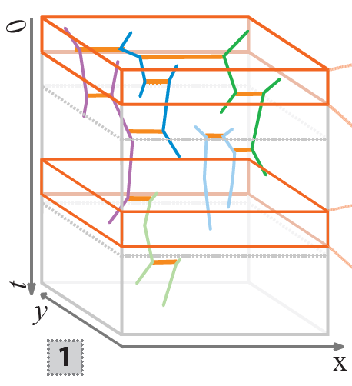
Temporal Network Visualization
Events are node/edge additions and removals
Events have time coordinates as real numbers
Nodes as trajectories in time
Space-Time-Cube (STC)
Notes:
Temporal networks differ from timesliced networks in that the time axis is no longer discrete - this means we can choose whatever time division we want, as we have the full temporal resolution.
In this case, the dynamics are modeled as events, such as, node and/or edge additions and removals.
These networks are typically drawn in 3D or 2D+t - Space-Time-Cube and the layout algorithms compute the node trajectories over time and space.

Slide 4
Drawbacks
Timesliced Networks:
many networks do not have natural time slices (yearly, monthly, etc.)
loss of temporal information (quantization error)
scalability with JP and AN
Temporal Networks:
STC (2D + t) layouts are computationally expensive
to visualize in 2D - timeslicing or animating between events
limited visualization research
Notes:
When we compare timesliced and temporal networks we can identify the following drawbacks:
For timesliced networks it is necessary to identify suitable time slices, which many networks do not naturally have.
Furthermore, timeslicing also leads inevitably to a loss of temporal information or quantization errors - this might lead to obscuring fine temporal details that may be important.
With the common visualization approaches JP and AN there are some scalability limitations in terms of how many changes and how many time slices can be visualized.
AN relies heavily on human memory – trying to keep track of all the changes occurring.
For temporal networks computing the STC layouts is computationally expensive.
In order to visualize temporal networks in 2D we still need to perform timeslicing for JP or transitioning between events using AN
There is also limited research on temporal network visualization.

Slide 5
Motivation
Why temporal networks?
No quantization error and no need to choose temporal resolution
Yield drawings of better quality compared to timesliced networks [1, 2]
Recent research on improving scalability of temporal graph layout
Why 2D projections of temporal networks?
Usually 2D + t or 3D (STC) representations can be difficult to explore
JP and AN do not scale well
2D representations are not explored
[1] Arleo et al. “Event-based Dynamic Graph Drawing without the Agonizing Pain” CGF (2022), 10.1111/cgf.1461
[2] Simonetto et al. “Event-based Dynamic Graph Visualisation” IEEE TVCG (2018), 10.1109/TVCG.2018.2886901
Notes:
So why are we interested in temporal networks?
Temporal networks do not suffer from quantization errors and there is no need for us to identify suitable time slices
Overall, they yield better quality drawings compared to time sliced networks
And there is also research being done on how to improve the scalability and computational complexity of the layout algorithms
And why do we to perform a 2D projection of temporal networks?
3D can be challenging to explore and interact with in order to extract insights from the networks.
JP and AN do not scale well for networks with many changes between time slices and many time slices
Other 2D representations of temporal networks are not explored in related literature.

Slide 6
Contribution
TimeLighting:
a guidance-enhanced Visual Analytics (VA) solution
2D approach displaying full temporal resolution
explore node trajectories
understand temporal patterns/behaviors
extract insights from complex temporal dynamics
Notes:
So with this motivation we present our contribution we called TimeLighting:
A guidance-enhanced visual analytics solution for exploring node trajectories in the space-time cube and preserving the full temporal resolution of the network.
It is a 2D approach and helps to extract insights from the networks dynamics and understand temporal patterns and behaviors

Slide 7
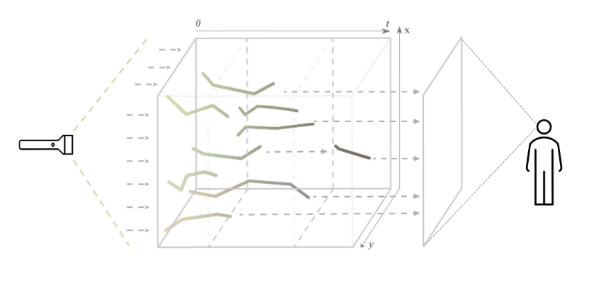
TimeLighting: Metaphor
Notes:
Exemplification of the TimeLighting metaphor.
Rays of light (depicted as dashed lines), coming from t = 0 travel through the space-time cube and reach the observer at t_max.
The rays interact with the node trajectories and will carry this information to the projection plane.

Slide 8
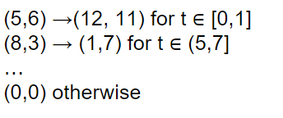
TimeLighting: Data
Appearance attribute models intervals where nodes and edges exist:
A_{v} : V × T → [true, false]
A_{e} : V × T → [true, false]
Temporal network D = (V, E, T)
V the set of nodes
E the set of edges
T ∈ ℜ time-dependent attributes
Nodes and edges have attributes
(piecewise linear functions in time)
V × T for nodes
E × T for edges
Position attribute models x, y coordinates of nodes in intervals where they exist [1]:
⎰
⎱
P_{v}(t) =
[1] Arleo et al. “Event-based Dynamic Graph Drawing without the Agonizing Pain” CGF (2022), 10.1111/cgf.1461
Notes:
The data we aim to visualize represents a temporal network, with a set of nodes, edges, and time-dependent attributes.
The nodes and edges are associated with these time-dependent attributes that take the form of piece-wise linear functions.
For example, in the temporal network layout, appearance and position are two crucial attributes for nodes and the appearance attribute only for edges.
However, also attributes can be modeled in this fashion as well (e.g., color, variables)
The embeddings in the space time cube - the position attribute of the nodes - are calculated using multidynnoslice

Slide 9
TimeLighting: Tasks
Based on task taxonomies for dynamic network visualization [1,2]
T1: Overview.
provide an overview of the temporal information
T2: Event Tracking.
understanding the dynamics and events' frequency
understand the node movement over time (e.g., speed, repetition, etc.)
T3: Investigate relationships.
edge events perturb the trajectories
identify relationships which have an impact or how often they occur
[1] Ahn et al. “A Task Taxonomy for Network Evolution Analysis” IEEE TVCG (2019), 10.1109/TVCG.2013.238
[2] Bach et al. “GraphDiaries: Animated Transitions and Temporal Navigation for Dynamic Networks” IEEE TVCG (2014), 10.1109/TVCG.2013.254
Notes:
The tasks we aim to support with timelighting are the following:
Overview - TimeLighting should provide an overview of the temporal information at a glance since this is typically the first step in any VA process
Tracking Events - Understanding the temporal dynamics and events’ frequency helps to isolate interesting occurrences in time. Since events can also cause the nodes’ trajectories to bend, understanding the shape of these changes would provide further insights during the exploration of the data
Investigate relationships - Each edge event occurrence perturbs the node trajectories, so identifying which relationships have the most impact or how often they occur can help explain the formation of clusters or generally the phenomenon at hand.

Slide 10
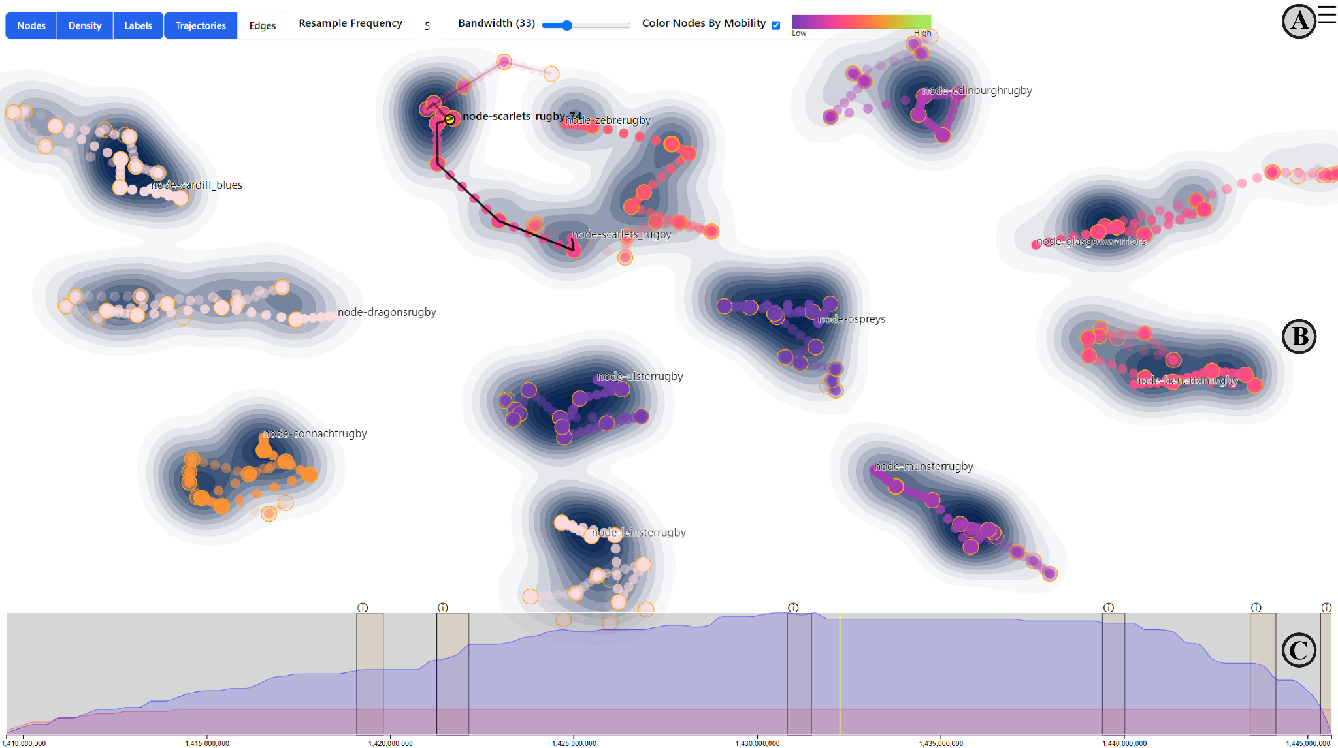
TimeLighting: Mainview
Toolbar
Main view
Event timeline
Notes:
This is the main view of TimeLighting.

Slide 11
TimeLighting: Mainview
Toolbar
Main view
Event timeline
Notes:
This is the main view of TimeLighting.
At the top there is the toolbar with some configuration options for the main view such as toggling certain visual elements on or off, enabling the node coloring by mobility, and nodes' resampling frequency or the bandwidth of the density map.
The main view shows a 2D projection of the complete temporal network, where the node trajectories are encoded as a trail of circles.
The density of node positions is represented as a contour map which is a quick visual indicator emphasizing locations where a large number of nodes have existed.
At the bottom the timeline allows to select specific temporal intervals and provides a quick overview of the number of nodes and edges that are visible over time.
In the following, I’ll go into a bit more details about all of these elements and provide some examples.

Slide 12
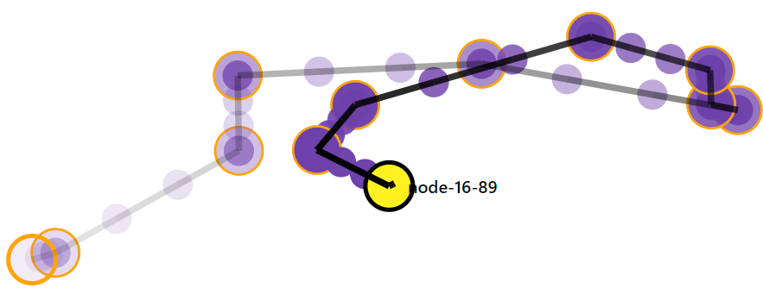
TimeLighting: Nodes & Trajectories
T1
T2
T3
Nodes are represented as trajectories encoded as a trail of circles
Trajectories are visualized using a polyline connecting of the nodes
Nodes at start and end intervals
Interpolated nodes
Notes:
Nodes are represented as circles and their trajectories over space and time are represented as a polyline or trails you can see in these example here.
We can also resample the nodes to ease the comprehension of the movement flow.
So between the start and end positions of each interval (depicted as the circles with the orange borders) we place a number of interpolated nodes, and the frequency can be adjusted by the user.
The opacity of the circles encodes the node aging, distant nodes in time (older ones) are more transparent and the more recent ones are more opaque.
This encoding makes it easier to understand the information about the progression and movement of each node over time.
The nodes can be color-coded according to their cumulative movement (a type of mobility score) indicating which ones have the longest or shortest trajectories respectively.

Slide 13
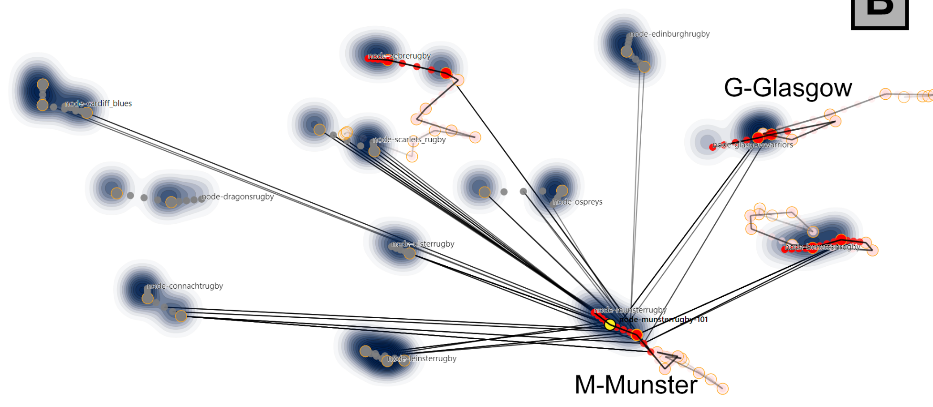
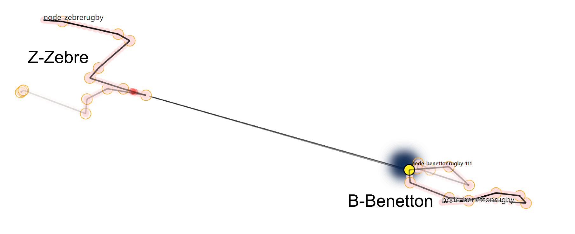
TimeLighting: Edges
T1
T2
T3
Edges are represented as solid straight lines that connect pairs of nodes belonging to two distinct trajectories
Notes:
The edges are represented as solid straight lines that connect pairs of nodes belonging to two distinct trajectories, including the resampled nodes to show finer temporal details.
Edges are important in this case as the relationships between nodes over time case them to move and create clusters at certain periods of time.
The edges use opacity to encode their aging similar to the way we do it for nodes.

Slide 14
TimeLighting: Timeline
T1
T2
T3
Timeline allows to select and explore specific temporal intervals as well as keep an overview
Time = milliseconds since epoch
Number of Edge Events
Time Windows of Interest
Number of Node Events
Notes:
The timeline allows to select and explore specific temporal interviews as well as keep an overview of the number of nodes and edges that appear over time.
Time here is left to right showing Unix time (ms since epoch).
We encode the number of node and edge events as area charts in the background of the timeline (red are the node events and blue are the edge events).
The timeline is interactive so you can brush to select a specific interval within the available data and the main view is updated accordingly.
We also superimpose rectangular areas that highlight intervals of interest, the information icons on top of each rectangle can be clicked and the selection snaps to that specific interval.
I will explain this in more detail in the following slides.

Slide 15
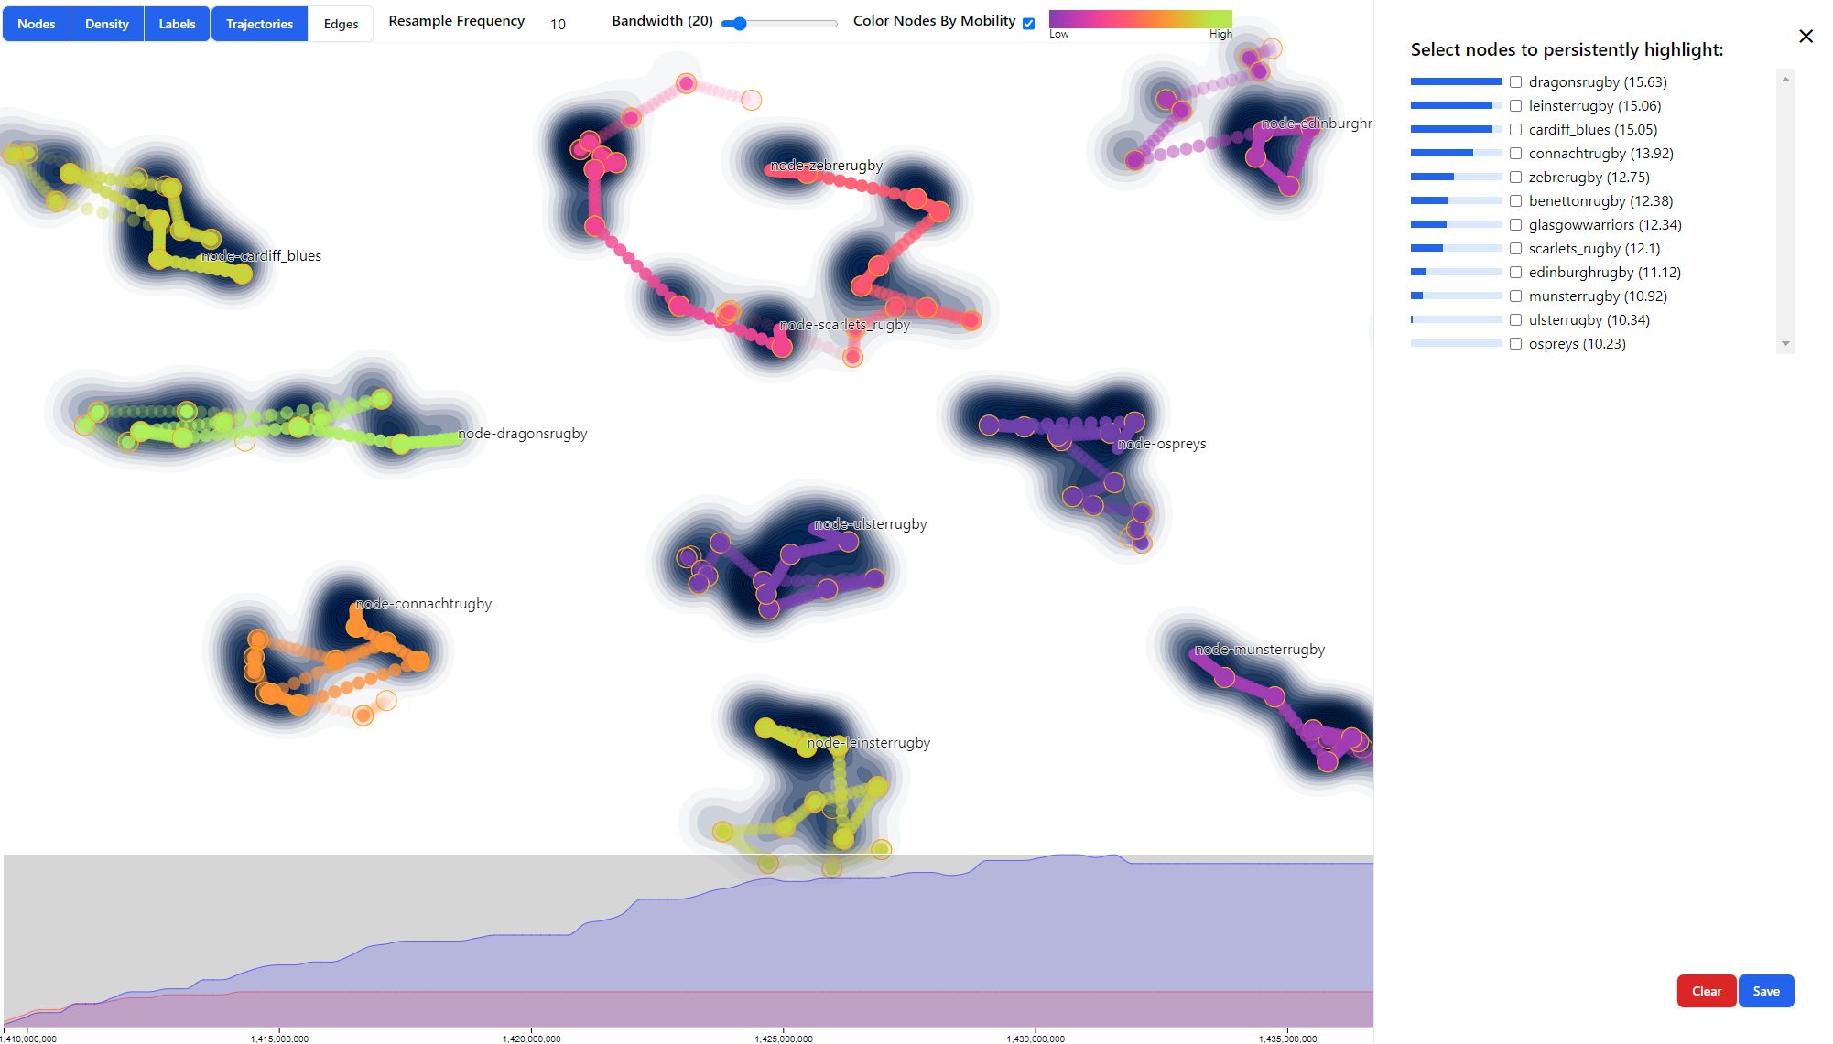
TimeLighting: Guidance (1)
T1
T2
T3
Guidance to
Side Panel shows a list of nodes ordered according to their mobility - bar charts
[1] Ceneda et al. “Characterizing guidance in visual analytics” IEEE TVCG (2016), 10.1109/TVCG.2016.2598468
Notes:
Due to the challenge of analyzing complex events in temporal networks, we investigate approaches to provide support and ease the analysis for users.
For this we use “guidance” which is characterized as active support in response to a knowledge gap that hinders the completion of an interactive visual data analysis session.
The Side Panel shows a list of nodes ordered according to their mobility as a form of guidance.
Mobility is calculated as the length of a nodes’ trajectory over the selected interval of time - how much a node moves over time
Each node in this list is also accompanied by a small barchart visualizing the differences in the mobility scores of the nodes.
From here, the user can select and “lock” trajectories in the main view.
A locked trajectory is always shown regardless of the current temporal interval selection in the timeline.
The encoding and ordering of node trajectories in the side panel serve as visual guidance to support the tracking of specific events
Additionally, when loading a new network, the three nodes with the highest mobility are locked by default - this can later be refined or changed

Slide 16
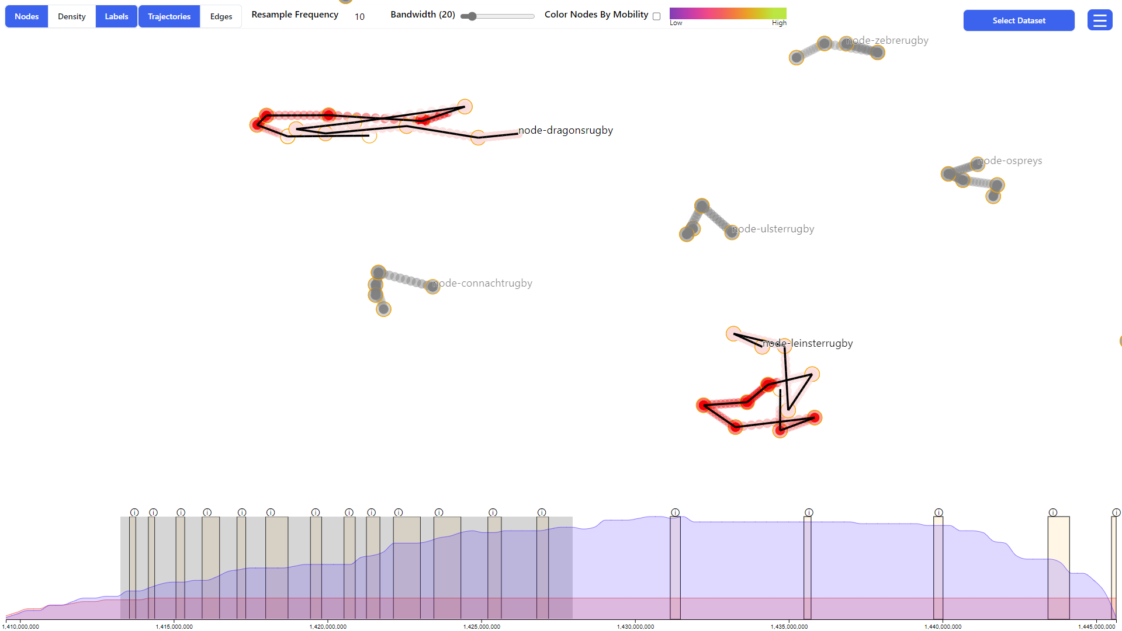
TimeLighting: Guidance (2)
T1
T2
T3
Timeline provides guidance - suggests specific time intervals for further inspection.
Time Windows of Interest
Notes:
The timeline provides guidance and suggests specific time intervals for further inspection.
Specifically, the system highlights intervals in time when all the currently locked trajectories interact with each other.
Locked nodes [-> trajectories] are colored in bright red if they are in the current temporal selection, while nodes that are out of the current temporal selection are colored in a less saturated hue.
The other trajectories are trimmed to the selected time interval and shown in grey – only ones in the current interval are displayed
These intervals on the timeline are represented as orange rectangles drawn on top of the timeline and are selectable.
Clicking one of these intervals will snap onto that temporal selection, helping the user to keep track of and investigate relationships.

Slide 17
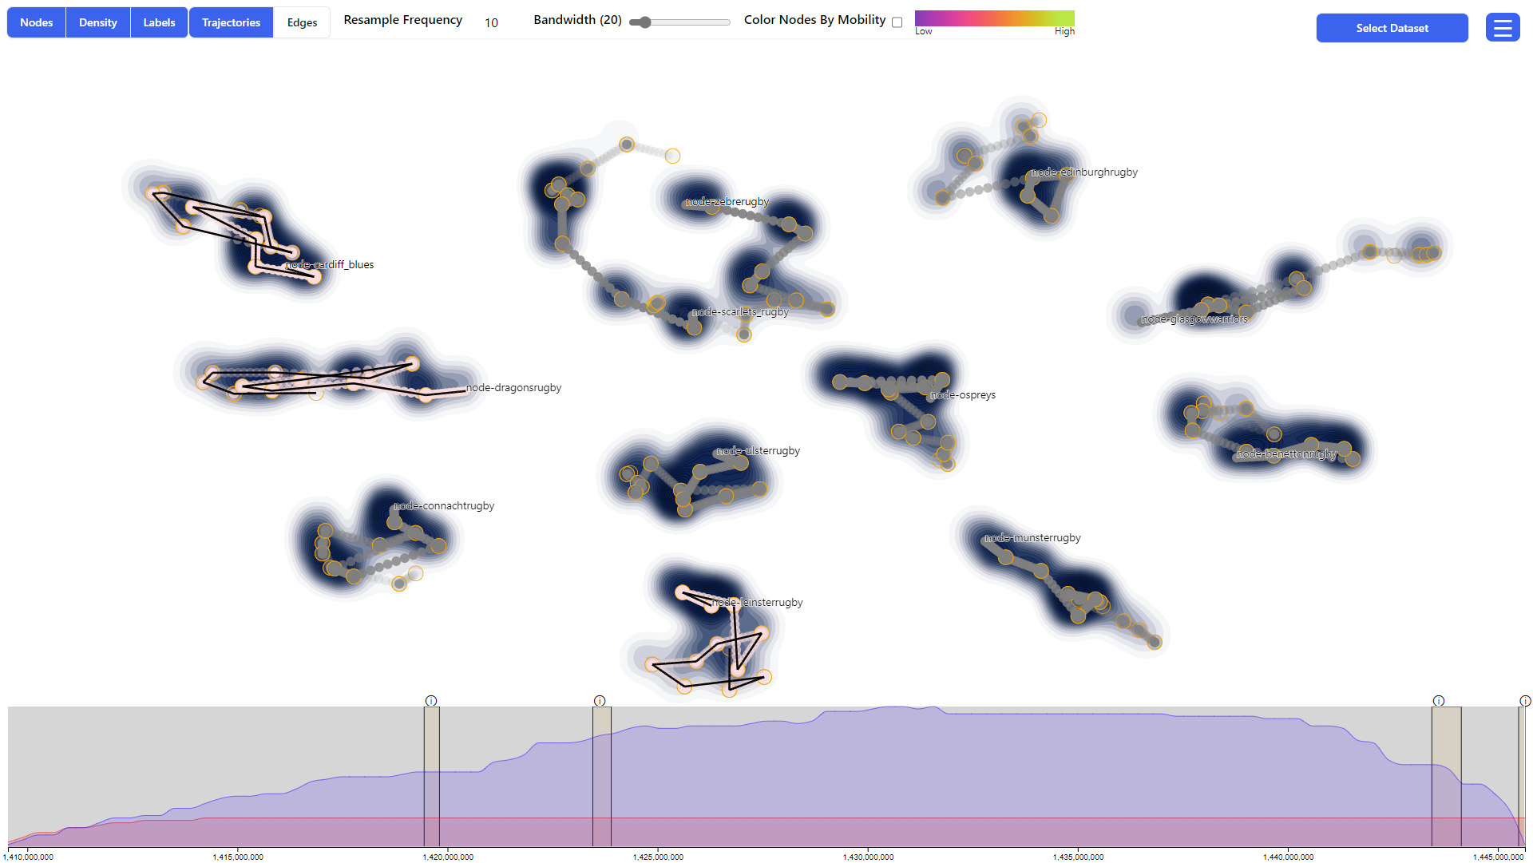
Use Case
Rugby competition (2014-2015)
3151 Tweets
12 teams
https://rd.pro12rugby.com/
https://en.wikipedia.org/wiki/2014-15_Pro12
Notes:
We build our case studies on the Rugby dataset, which is a collection of 3151 tweets posted during the Pro12 rugby competition of the 2014-2015 season.
Specifically, from September 2014 to October 2015.
The network has a node for each team participating in the competition (12 in total), and an edge exists between two teams when a tweet from one mentions another.

Slide 18
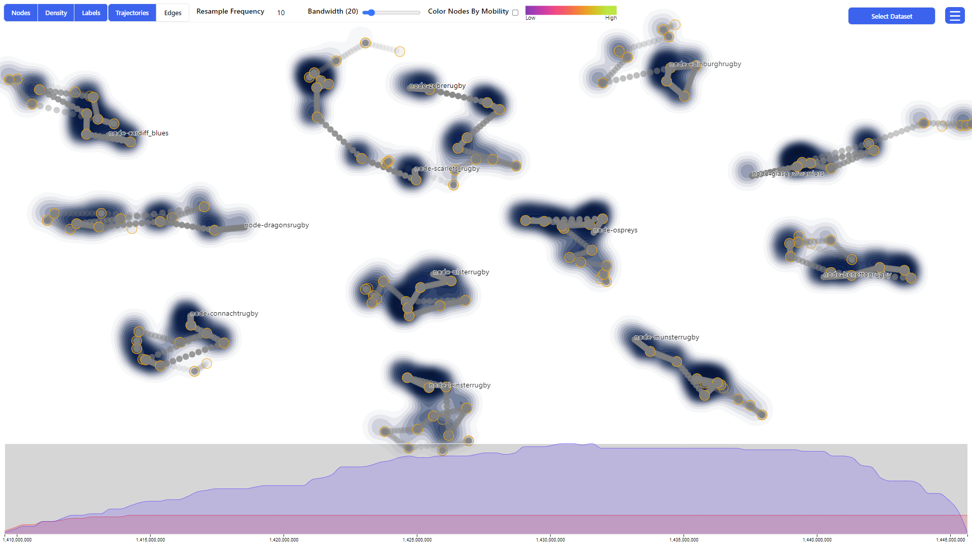
Use Case
Click sidebar
Notes:
We track the trajectories and relationships between the two least winning teams of the season - “Zebre” (Z) and “Benetton” (B) teams
We begin by selecting them in the sidebar so that the the trajectories are locked.
Guidance shows us the different moments in time when the two teams interact, and we focus on the period of time when the two teams play against each other around the midpoint of the season.

Slide 19
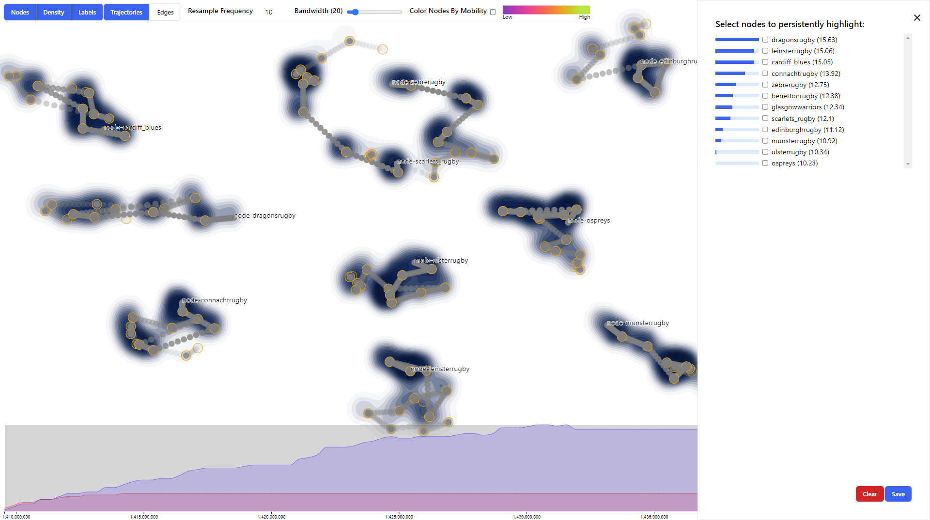
Use Case
Find teams
Notes:
We track the trajectories and relationships between the two least winning teams of the season - “Zebre” (Z) and “Benetton” (B) teams

Slide 20
Use Case
Save selection
Notes:
We begin by selecting them in the sidebar so that the the trajectories are locked.

Slide 21
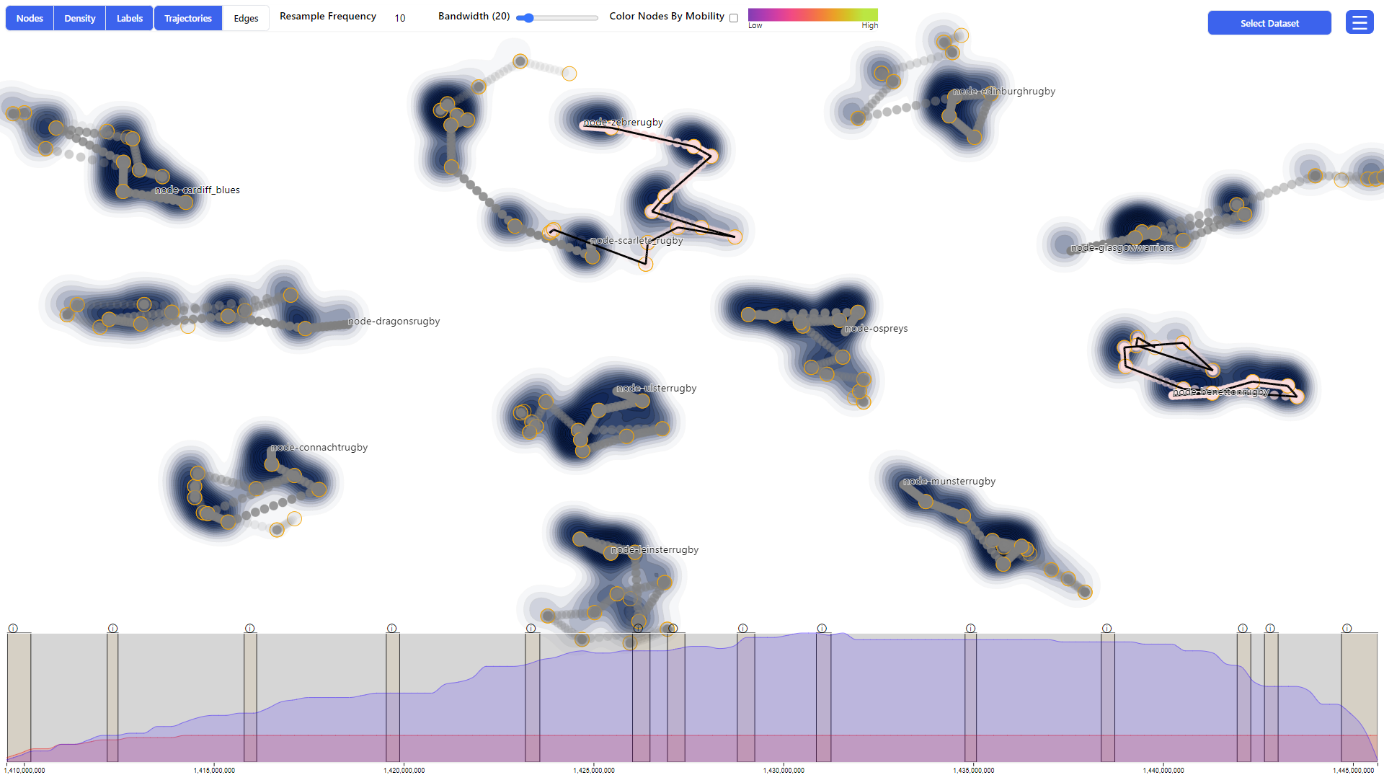
Use Case
Trajectories locked
Notes:
Now their trajectories are locked in place. So we can also see some intervals highlighted in the timeline..

Slide 22
Use Case
Investigate the match
Notes:
Guidance shows us the different moments in time when the two teams interact, and we focus on the period of time when the two teams play against each other around the midpoint of the season.

Slide 23
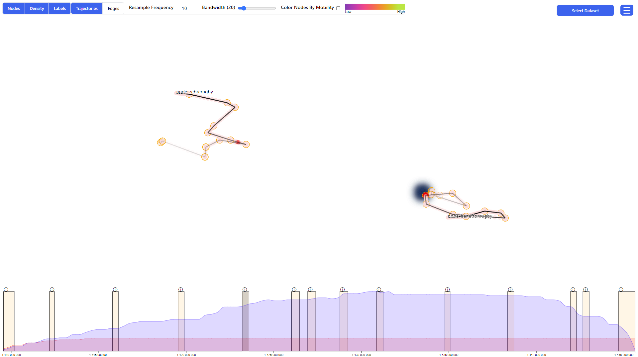
Use Case
vs
“Hype” building up
Notes:
It is possible to see how the Z trajectory bends significantly towards B at this point in time, and a similar effect is visible the other way around.
This attraction strength can be interpreted as the “hype” of the matches building up, as Z and B are the only two teams coming from Italy in the competition.

Slide 24
Use Case
Click sidebar
Notes:
Finally, we compare the relationships between the two most winning teams in the ranking “Glasgow Warriors” (G) and “Munster Rugby” (M) - and the first two Zebre and Benetton.

Slide 25
Use Case
Select and save
Notes:
We select all the teams in the sidebar to lock the trajectories.

Slide 26
Use Case
Focus on Munster
Notes:
We focus on M.

Slide 27
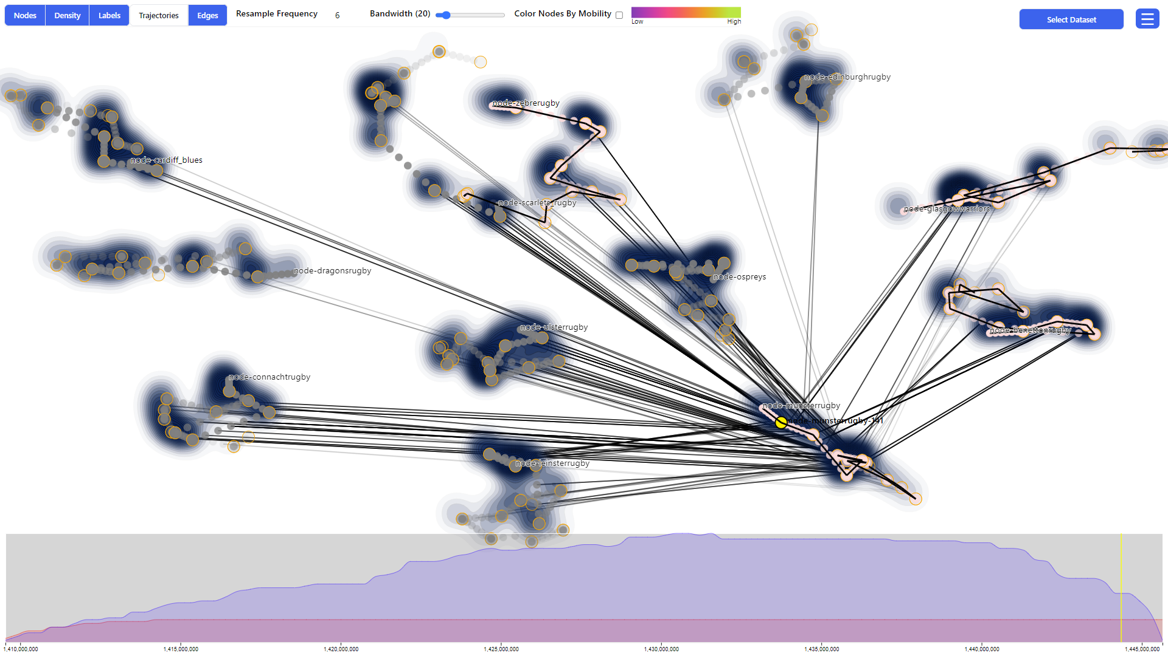
Use Case
Focus on Munster
Notes:
We can see it is interacted with mostly all teams - and look more towards the end of the season – there is a yellow line on the timeline indicating the point in time where are inspecting.

Slide 28
Use Case
Before playoffs
Notes:
We proceed by brushing around the end of the season to explore the relationships between Munster and the other teams around the finals in more detail.

Slide 29
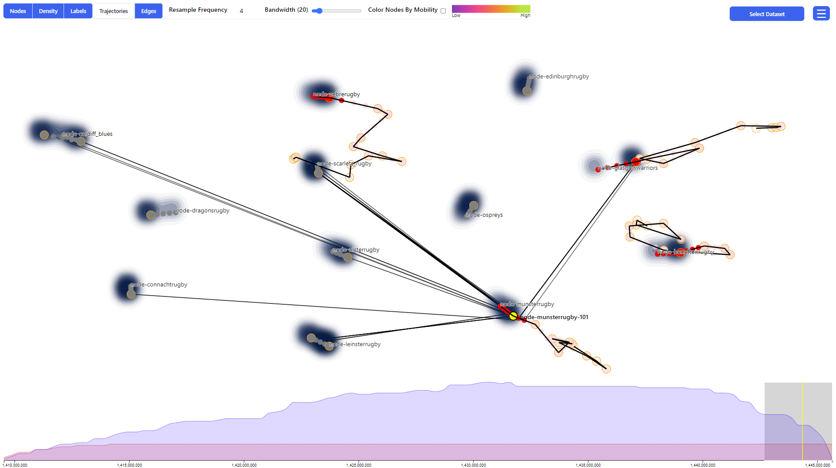
Use Case
Final Munster vs Glasgow
https://en.wikipedia.org/wiki/2014-15_Pro12
Notes:
The final match of the season was Munster vs Glasgow Warriors.
It is possible to see how this event influenced the movement of the nodes -> the trajectories
Glasgow Warriors won 31 to 13 - you can find more information about the season on Wikipedia.

Slide 30
Future Work
Investigate how visualization supports users when (re-)sampling temporal networks
Comparison study between timesliced and event-based network visualizations
Evaluation providing more evidence for the quality of the results and insights that can be extracted
Notes:
Some interesting directions for future work we identified are the following:
Investigate how TimeLighting supports users when sampling and identifying temporal network features and patterns.
Conducting a formal evaluation of the method, both from a visual quality perspective, i.e., through a selection of metrics (readability, scalability, and expressiveness).
And from a user perspective, assessing the impact of the guidance features included in the system, the quality of the results and insights, and extending experimentation on other real datasets

Slide 31
Conclusion
TimeLighting is a guidance-enhanced VA approach supporting temporal networks analysis
2D projection of temporal networks visualized in STC
Two kinds of guidance to navigate the network structural and temporal aspects
Notes:
We presented and TimeLighting a guidance-enhanced VA approach to support the analysis and exploration of temporal networks.
We propose a method of projecting temporal networks from a Space-Time-Cube into a 2D visualization.
We apply two kinds of guidance to navigated the structural and temporal aspects of the network and demonstrate the effectiveness in a case study, depicting the dynamics of a rugby season and the relationships between teams.

Slide 32
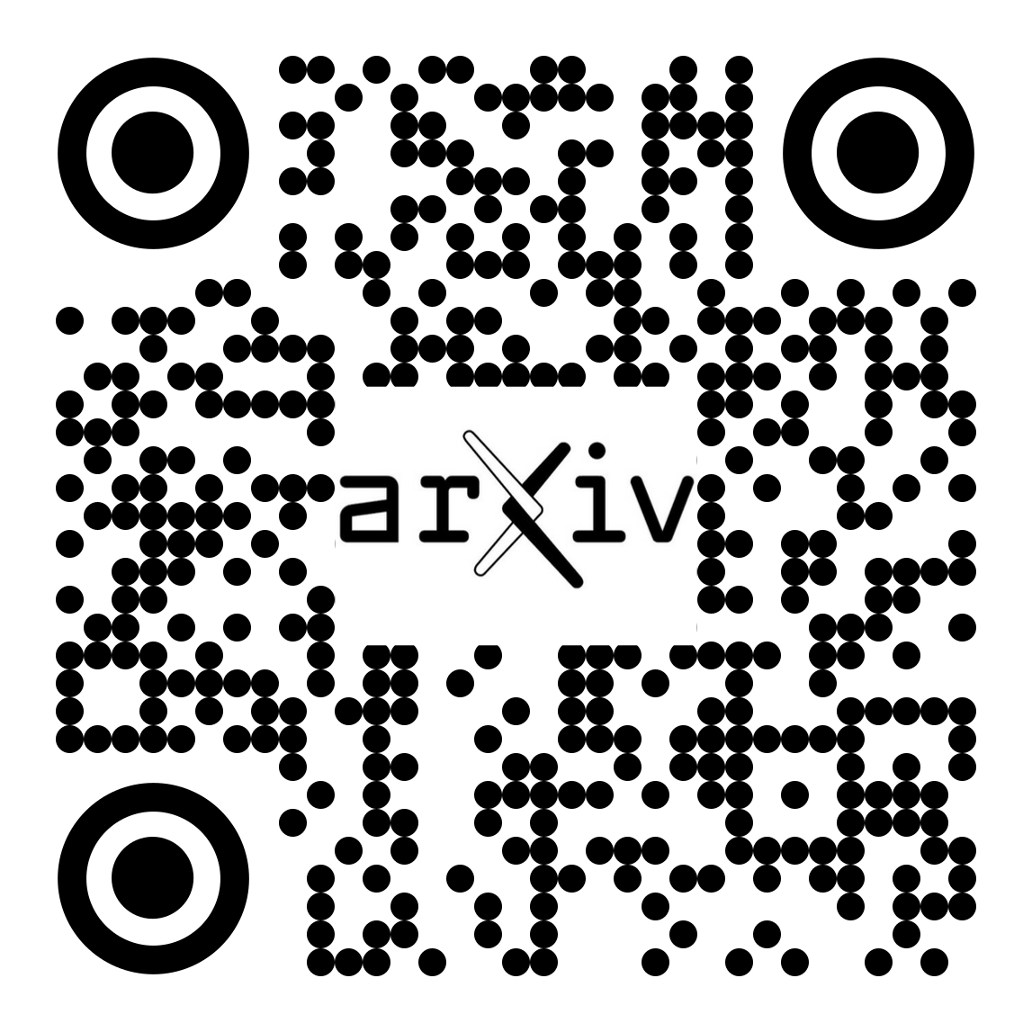
Thank you!
Contact Velitchko Filipov
velitchko.filipov@tuwien.ac.at
Notes:
Thank you for your attention.
Feel free to ask questions - or talk to me after.
Here you can find the QR codes for the arxiv version and the gitlab repository of the project.

Slide 34
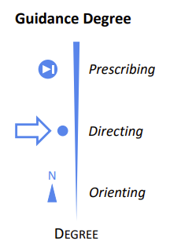
Guidance
Prescribing:
Prescribe a series of actions / steps to take
to conclude the current analysis task.
Orienting:
Helps to maintain an overview of the problem
and the alternative analytical paths that can be
taken to progress towards the analytical goal.
[1] Ceneda et al. “Characterizing guidance in visual analytics” IEEE TVCG (2016), 10.1109/TVCG.2016.2598468

