Slide 1
Manipulating Weights to Improve Stress-Graph Drawings of 3-Connected Planar Graphs
Alvin Chiu, David Eppstein, Michael Goodrich
University of California, Irvine
Notes:
PREVIOUS YEARS SLIDES: http://www.csun.edu/gd2015/presentations.htm.

Slide 2
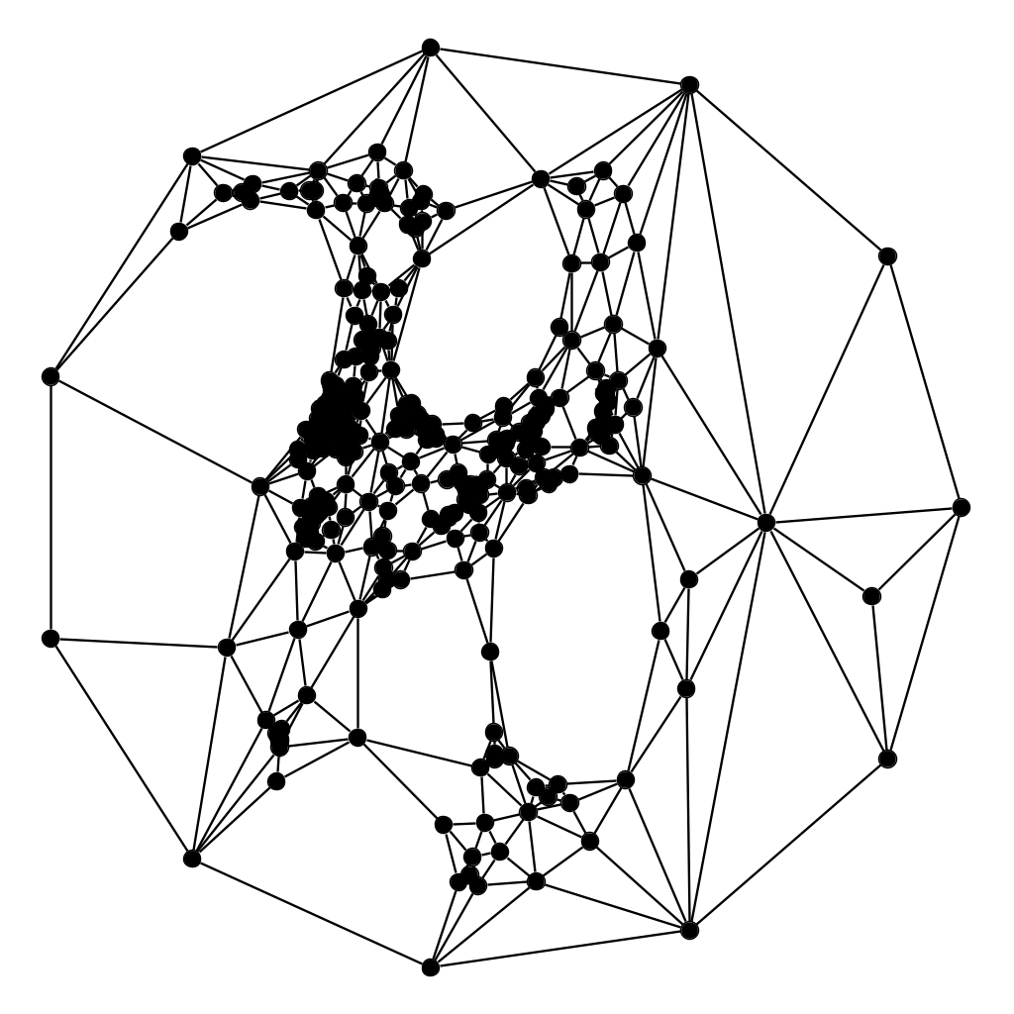
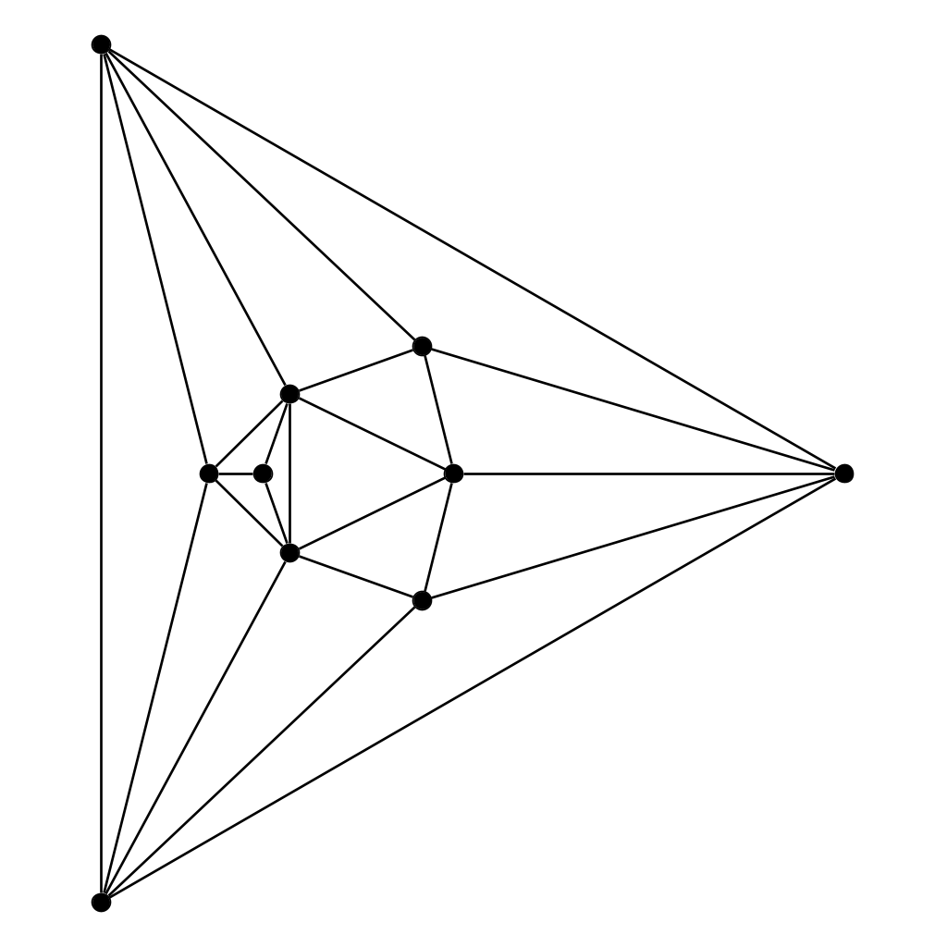
Tutte Embedding
[Fáry's theorem] Any simple, planar graph can be drawn without crossings using straight line edges.
[63 Tutte] Algorithm constructs a straight-line drawing without crossings where all faces are convex for any 3-connected planar graphs.
Sets a vertex to be the average of its neighbors’ positions.
Let graph G = (V, E). Fix one face as a convex polygon to be the outer face.
Assign stress weights w_{uv} = 1 for all edges uv.
Let p_{v} be the position of vertex v. For all internal (not fixed) vertices v, we want to satisfy:
Notes:
3-connected planar ⇔ convex polyhedron, 2-connected = biconnected. A graph is k-connected if it remains connected when less than k vertices are removed. Arbitrary planar graph drawing: add edges till 3-connected,use Tutte, then remove those edges

Slide 3
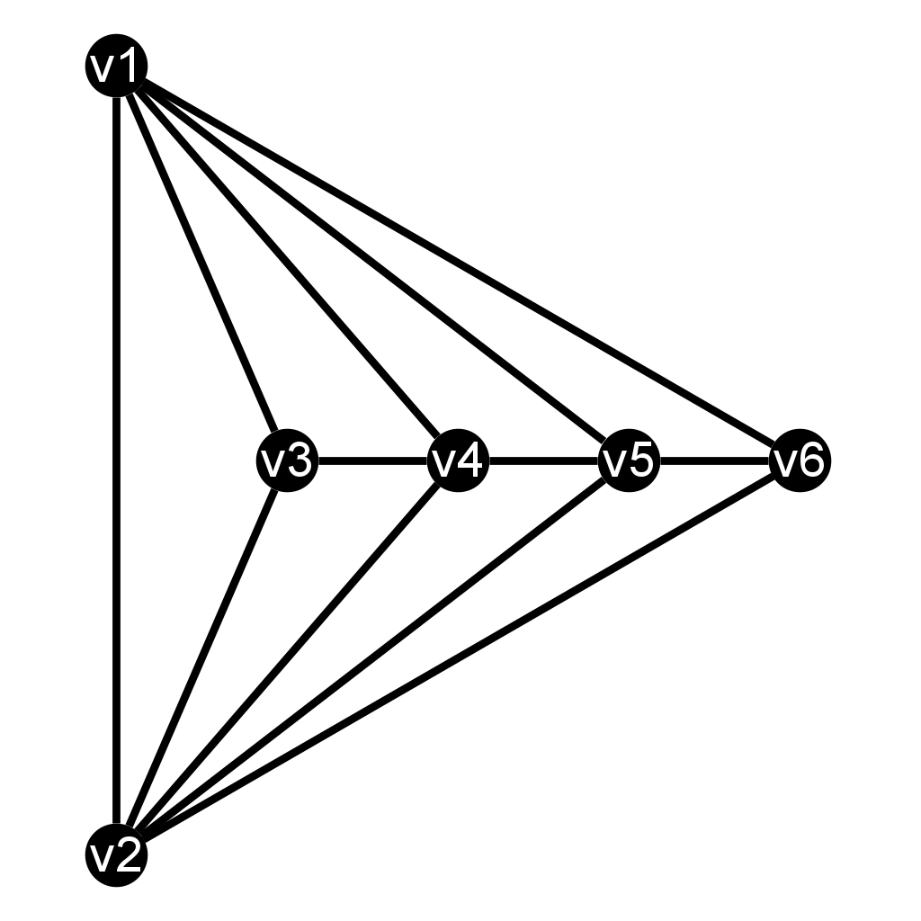
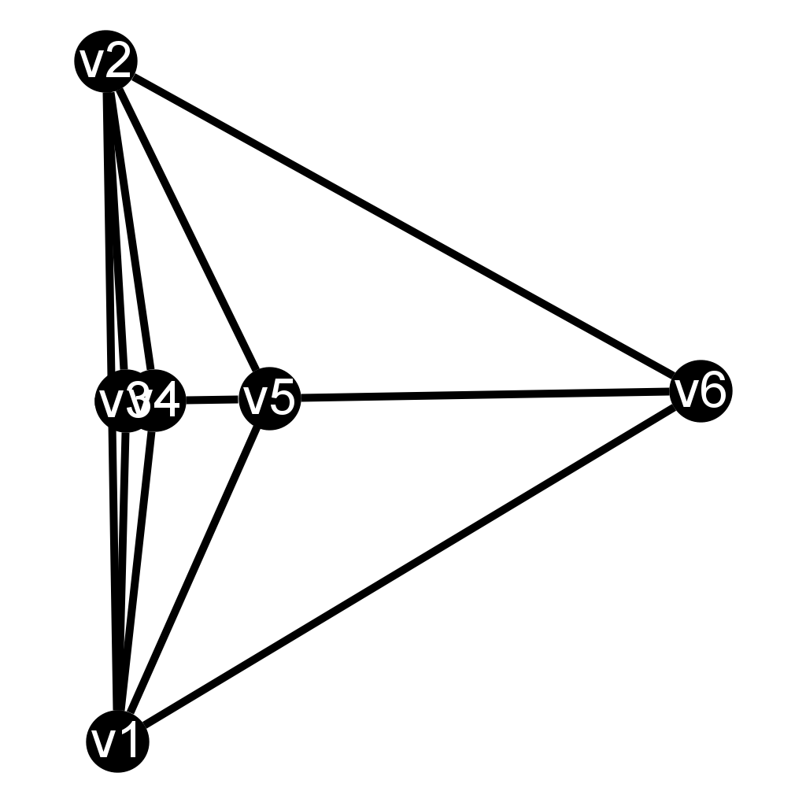
Worst Case for Tutte Embeddings
Before Tutte
Consider the following graph G with vertices v₁, v₂, …, v_{n} where x₀ = x₁ = 0 and x₂ = 1.
[96 Eades, Garvan] The Tutte drawing 𝜞 of this graph has an exponential edge-length ratio.
𝝆(𝜞) = Edge-length ratio of drawing 𝜞 = longest edge / shortest edge
Recurrence equation: x_{i} = 4x₁₋₁ - x_{i-2}
after Tutte

Slide 4
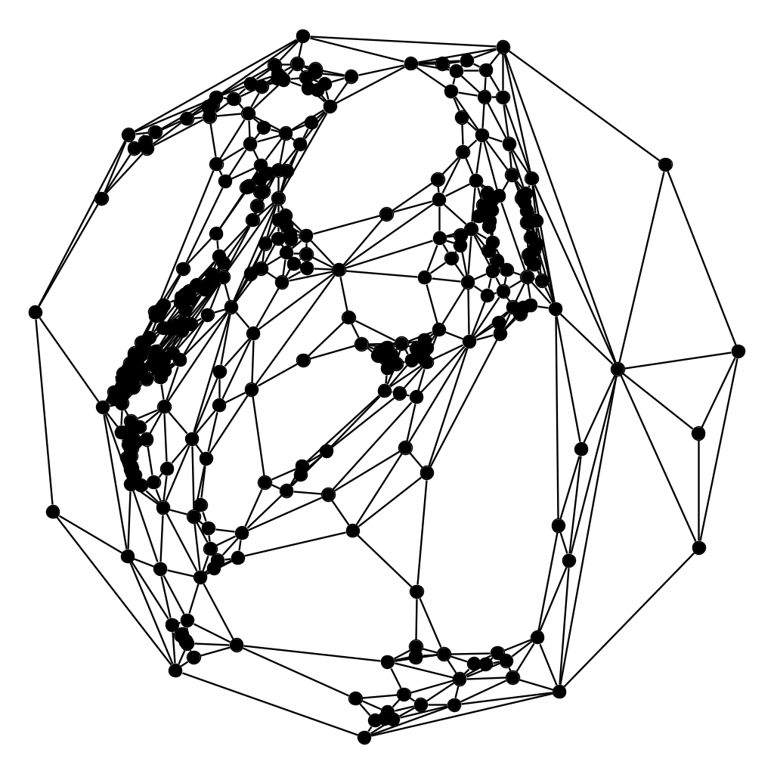
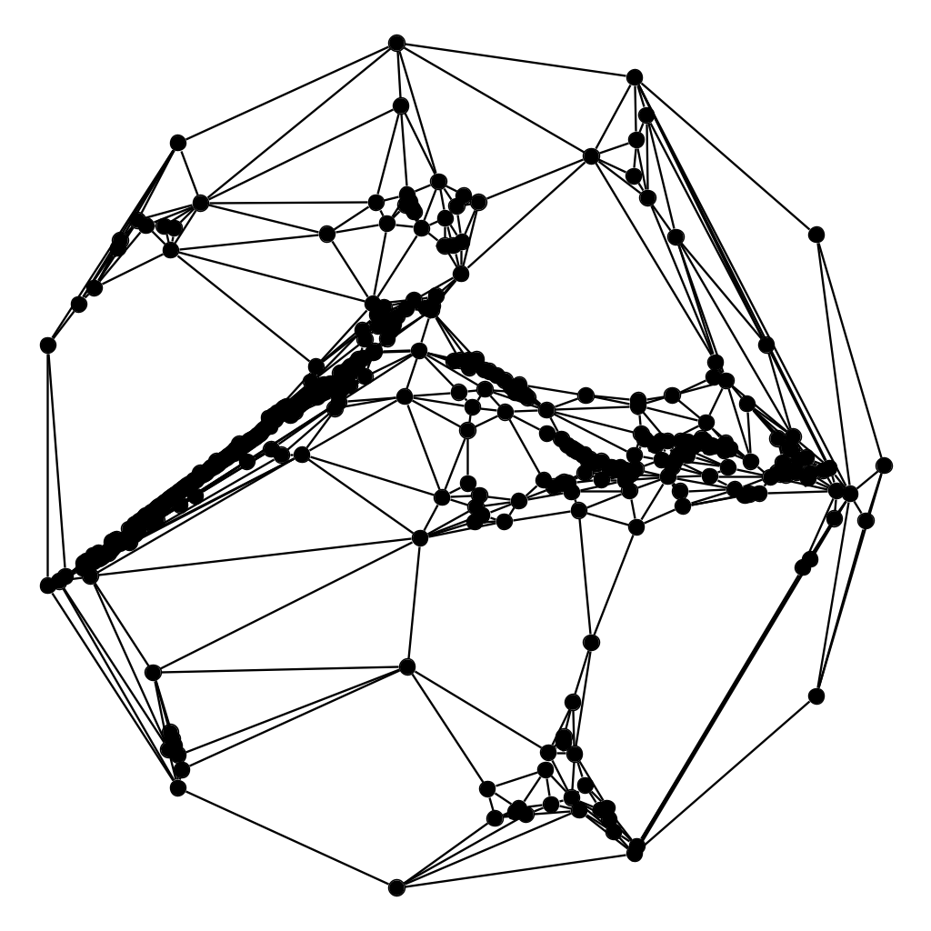
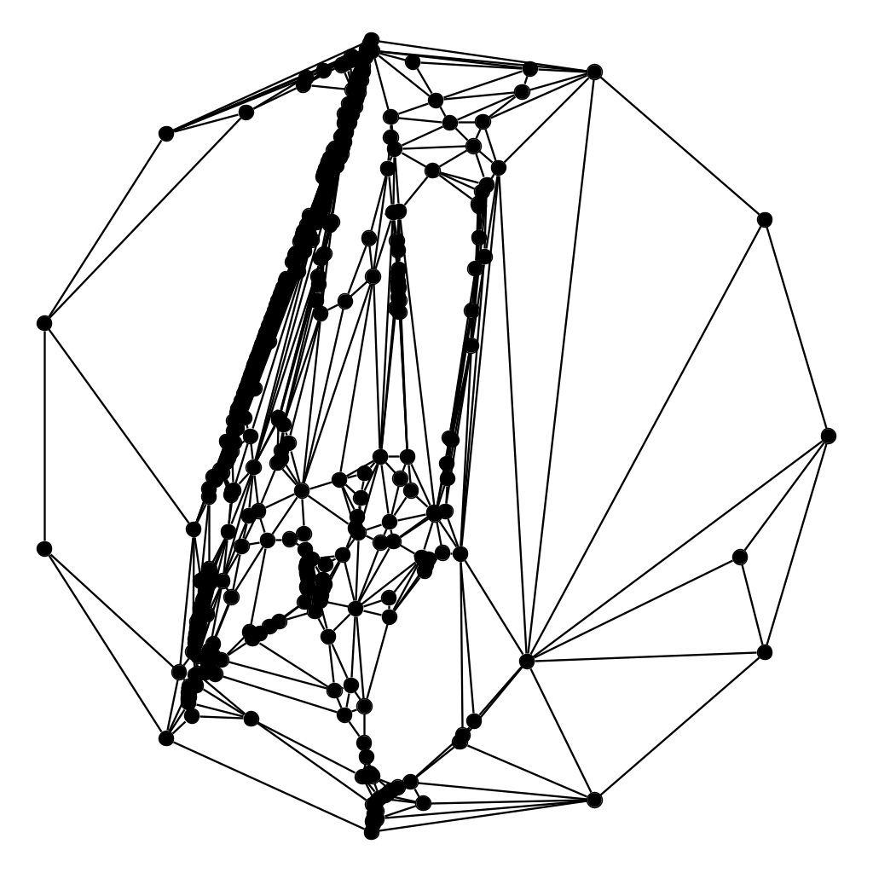
Tutte Embedding Weight Manipulation
[89 Hopcroft-Kahn] Any assignment of positive stress weights will uniquely and smoothly produce a convex drawing with no crossings.
Goal: Manipulate the stress weights to alleviate the cluttering of vertices and exponential edge-length ratio caused by Tutte’s algorithm.
Approaches:
Spread vertices closer to the boundary (BFS-spread, Schnyder-spread).
Spread vertices in a chosen direction, such as in the x-direction or y-direction.
Tutte for G(400,1100),
𝝆(𝜞) = 56162
BFS-spread, 𝝆(𝜞) = 9092
x-spread, 𝝆(𝜞) = 288
y-spread, 𝝆(𝜞) = 334
Notes:
Schneeder

Slide 5
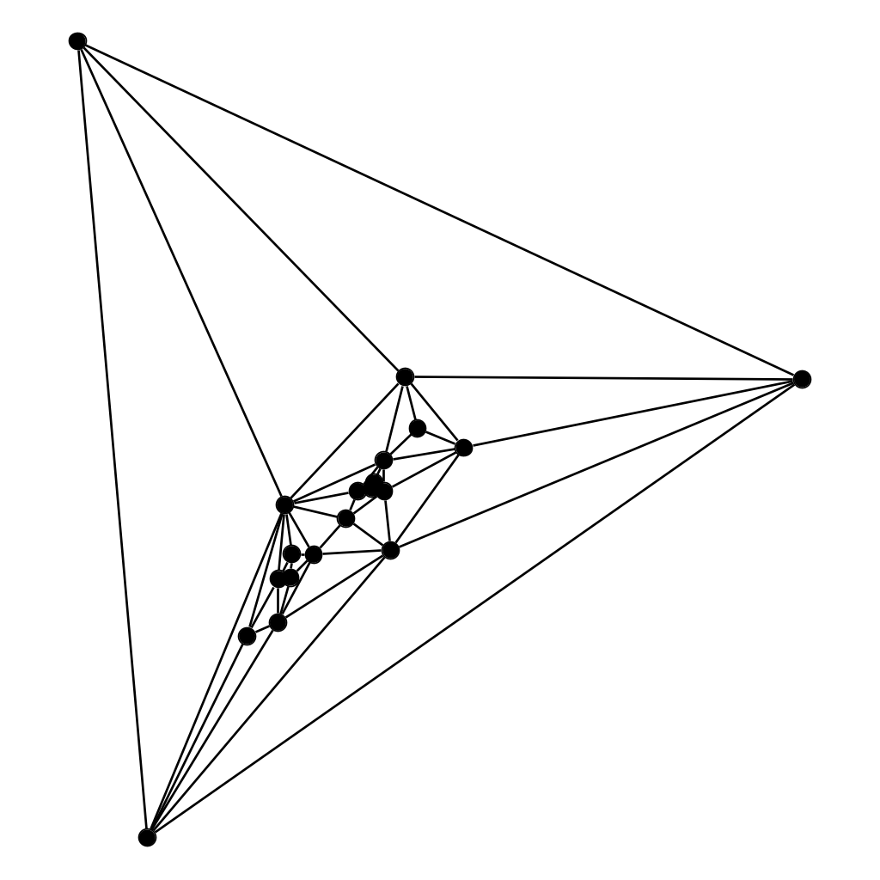
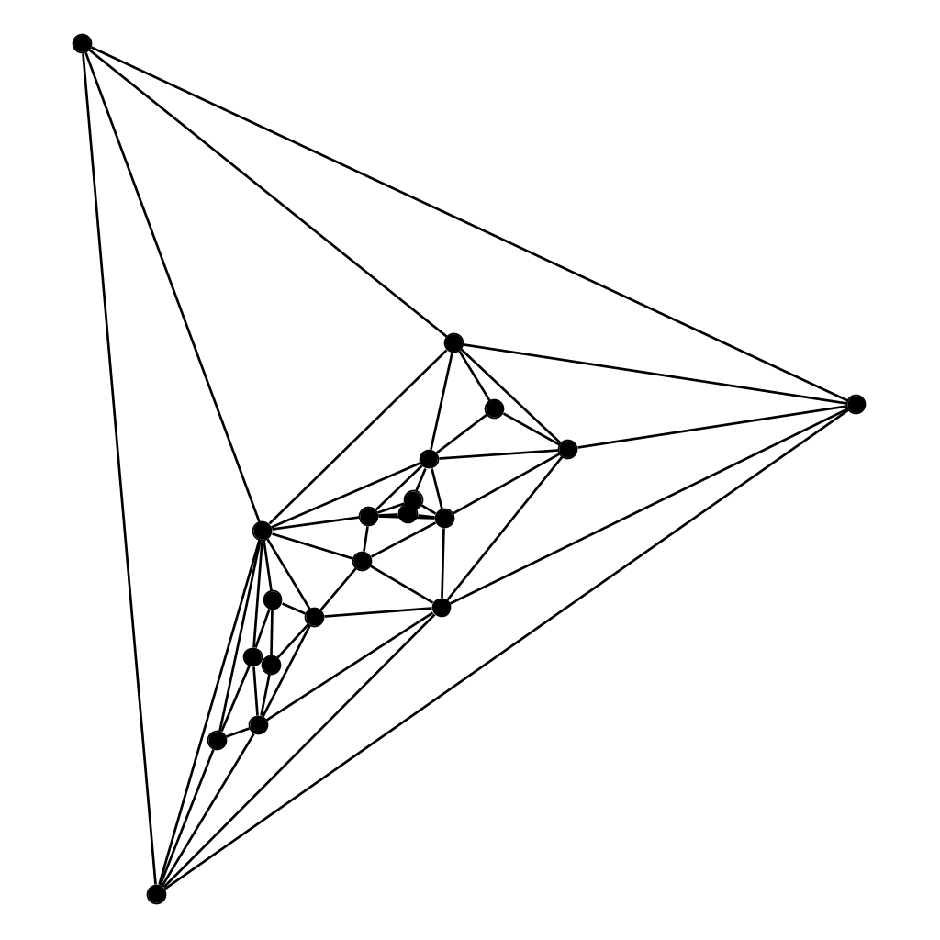
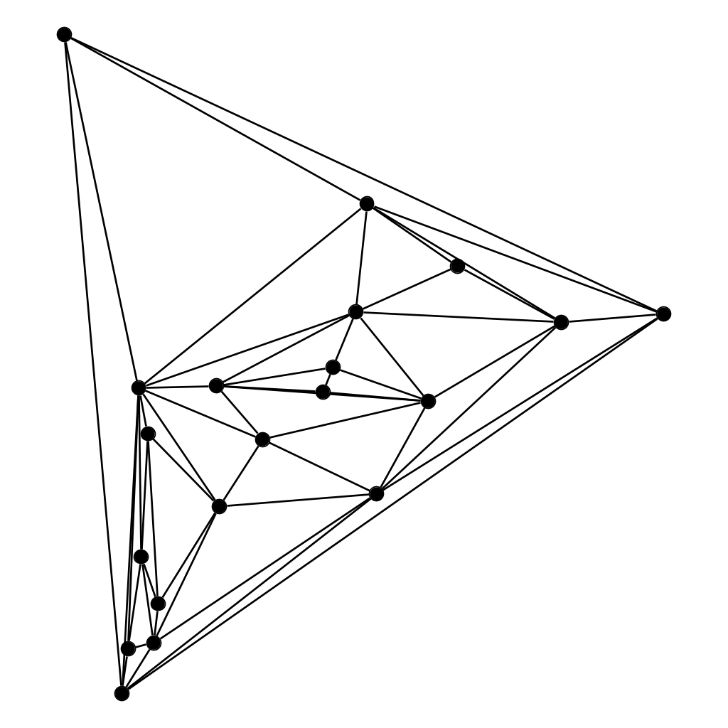
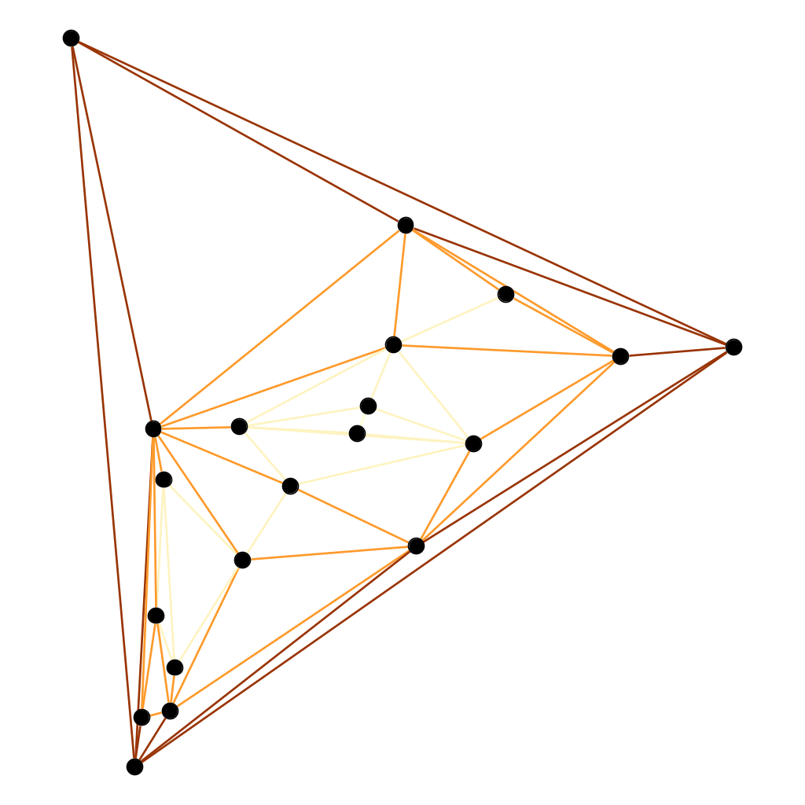
BFS Spread
Find a set of edge-covering spanning trees rooted at the outer vertices.
Breadth-first search (BFS) trees are used here.
Let the depth d(e) of an edge e be the number of edges on the path from the root to the edge (plus one for itself).
Set the weight of an edge to 1/r^{d(e)}, where r is a scaling parameter.
Tutte for G(20,54)
𝝆(𝜞) = 131.74
r = 2, 𝝆(𝜞) = 58.14
r = 8, 𝝆(𝜞) = 25.15
Colored by depth
Notes:
G(20,54) seed 7.

Slide 6
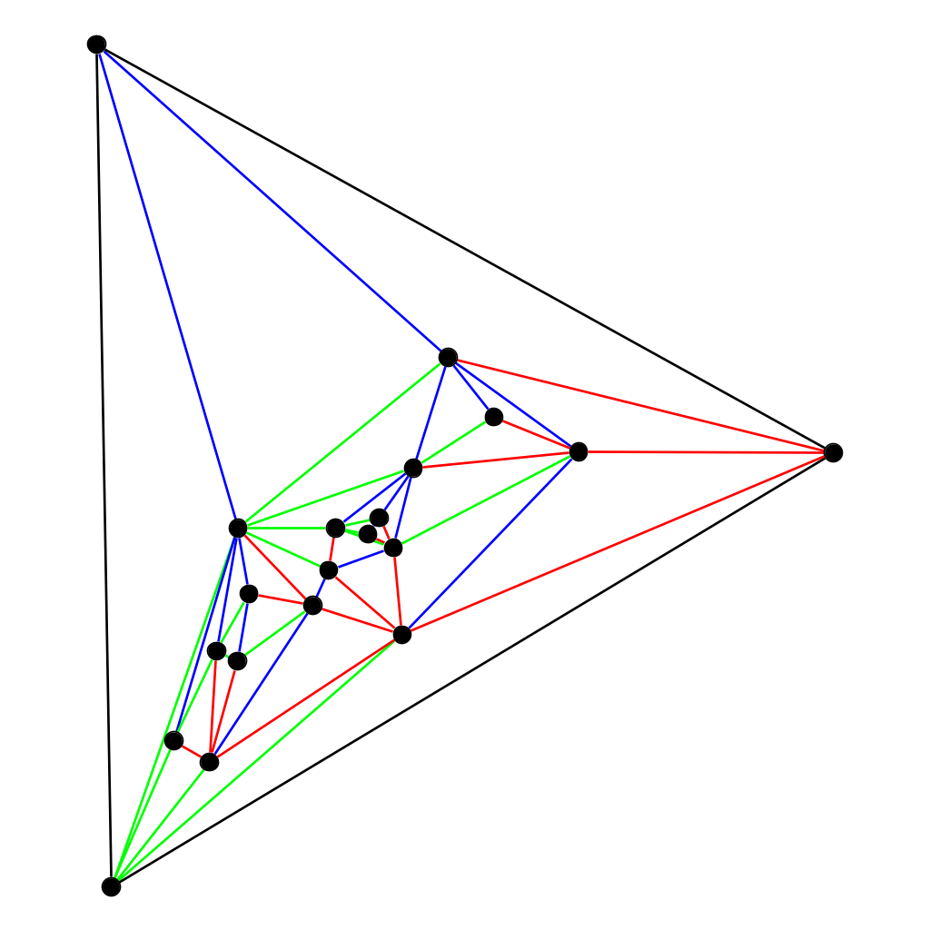
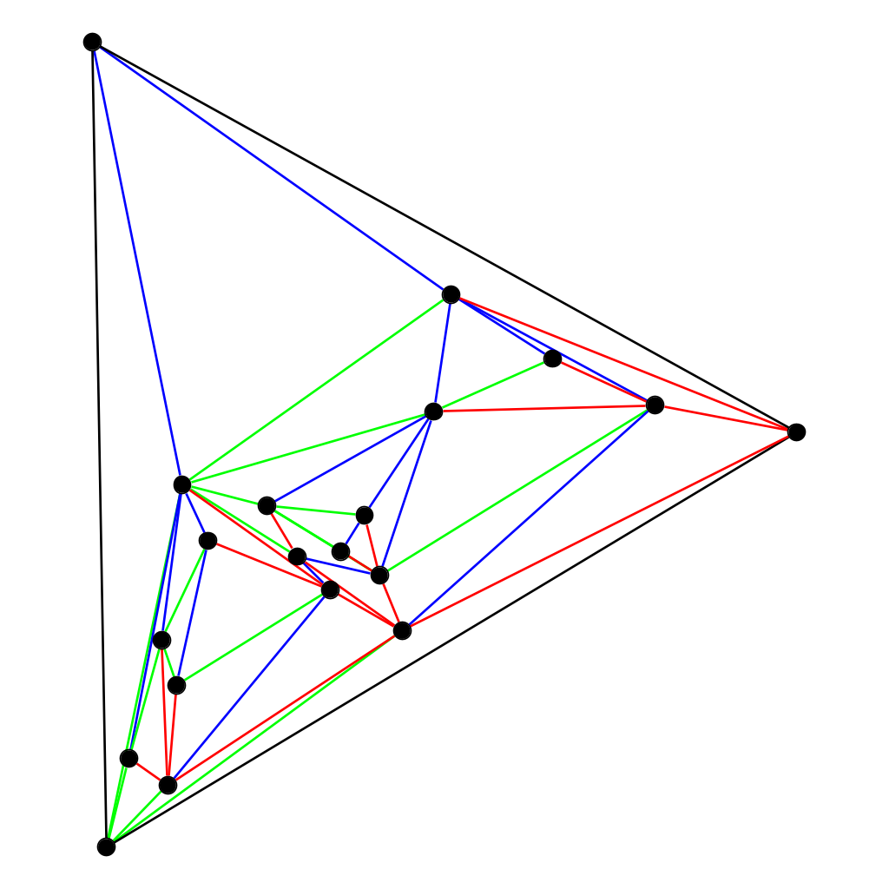
Schnyder Spread
Same idea, but the edge-covering spanning trees rooted at the outer vertices are now Schnyder trees.
Only applies to fully triangulated planar graphs.
Tutte for G(20,54)
𝝆(𝜞) = 131.74
r = 2, 𝝆(𝜞) = 42.47
r = 3.75, 𝝆(𝜞) = 18.69

Slide 7
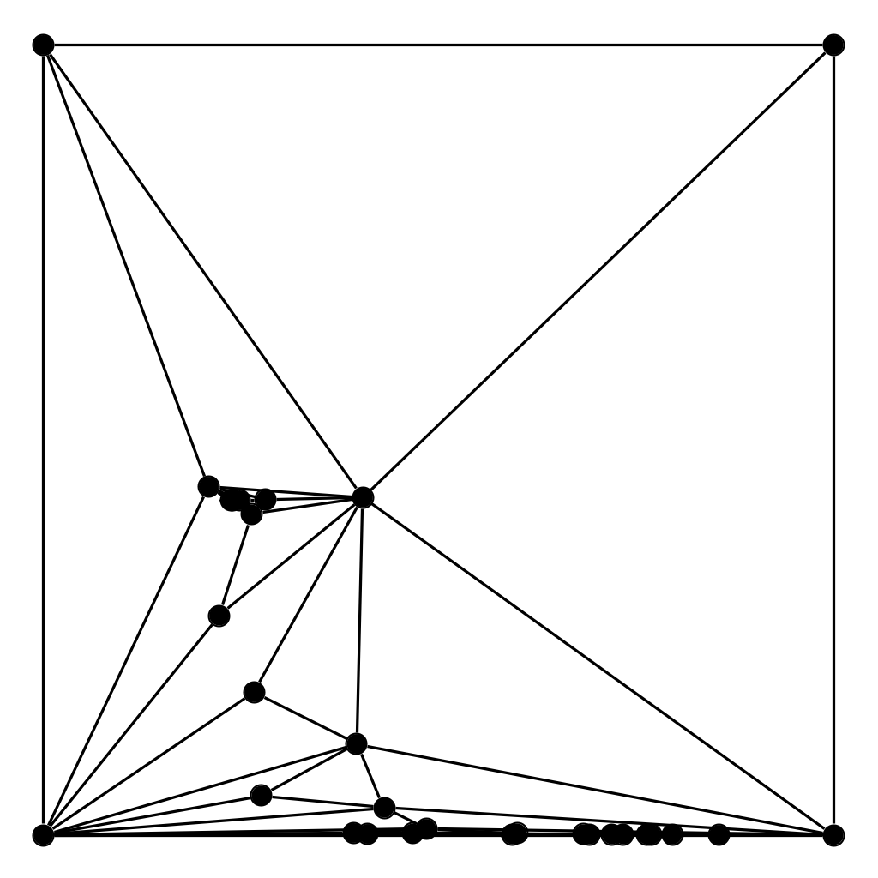
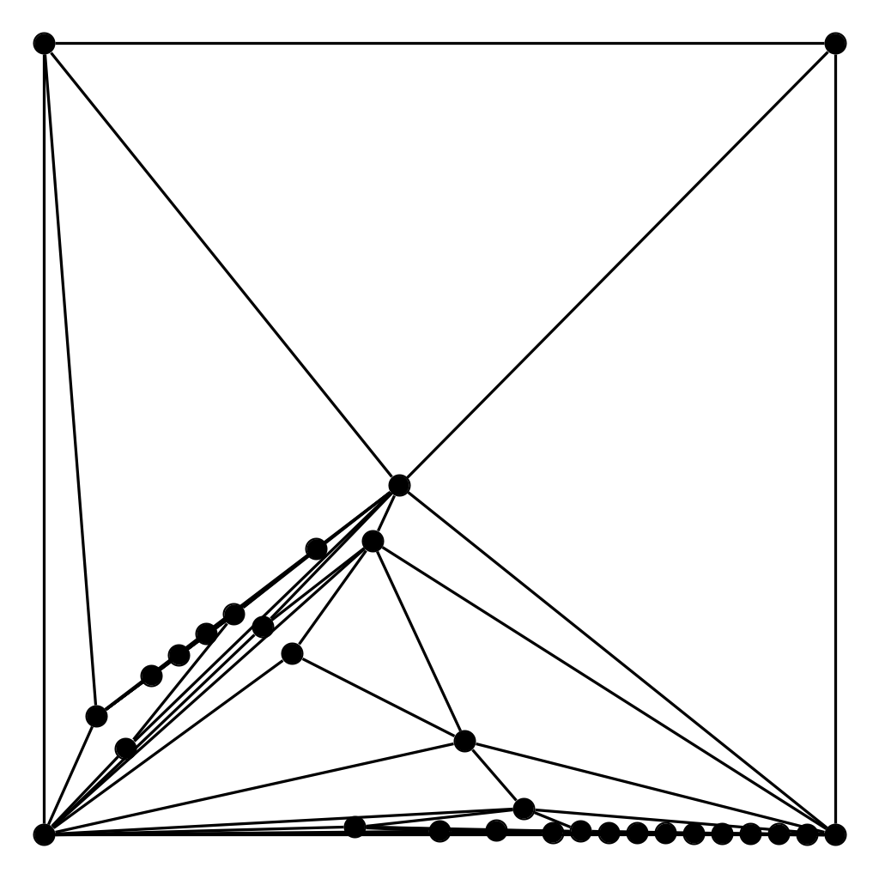
Our Contribution
Tutte for G(30,80)
[96 Chrobak, Goodrich, Tamassia] Linear time algorithm for constructing a convex drawing with O(1) x O(n) area with shortest edge of length 1.
[11 Schulz] Corrected proof to work for any outer face, not just triangular outer faces.
Main Result: Let G be a graph with an unweighted Tutte drawing and let its vertices be ordered by the st-ordering from left to right. Then we manipulate the weights such that a weighted Tutte drawing evenly spreads out the internal vertices according to this ordering.
x-spread
Notes:
TamaSIA

Slide 8
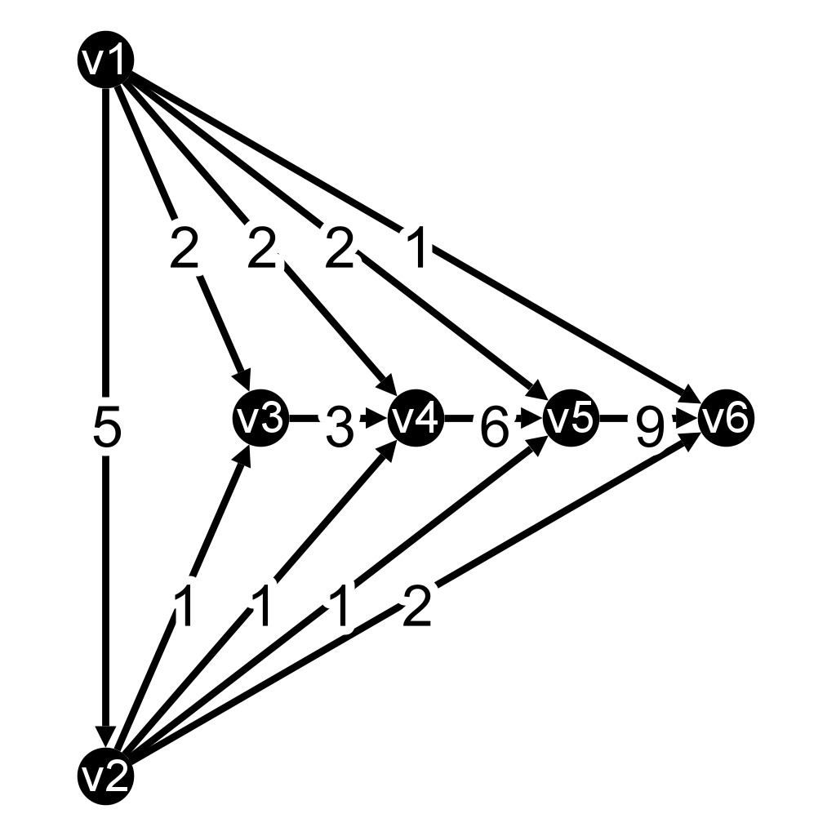
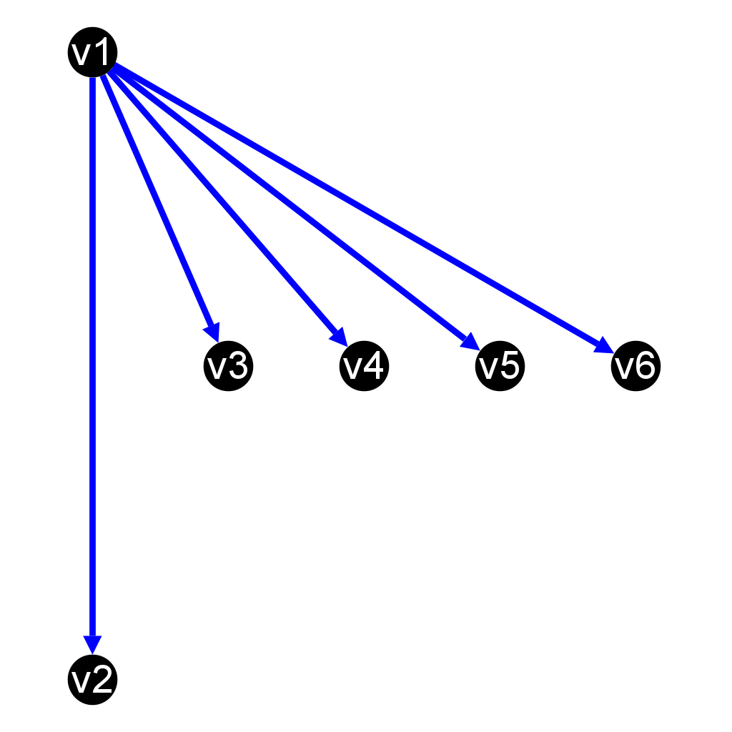
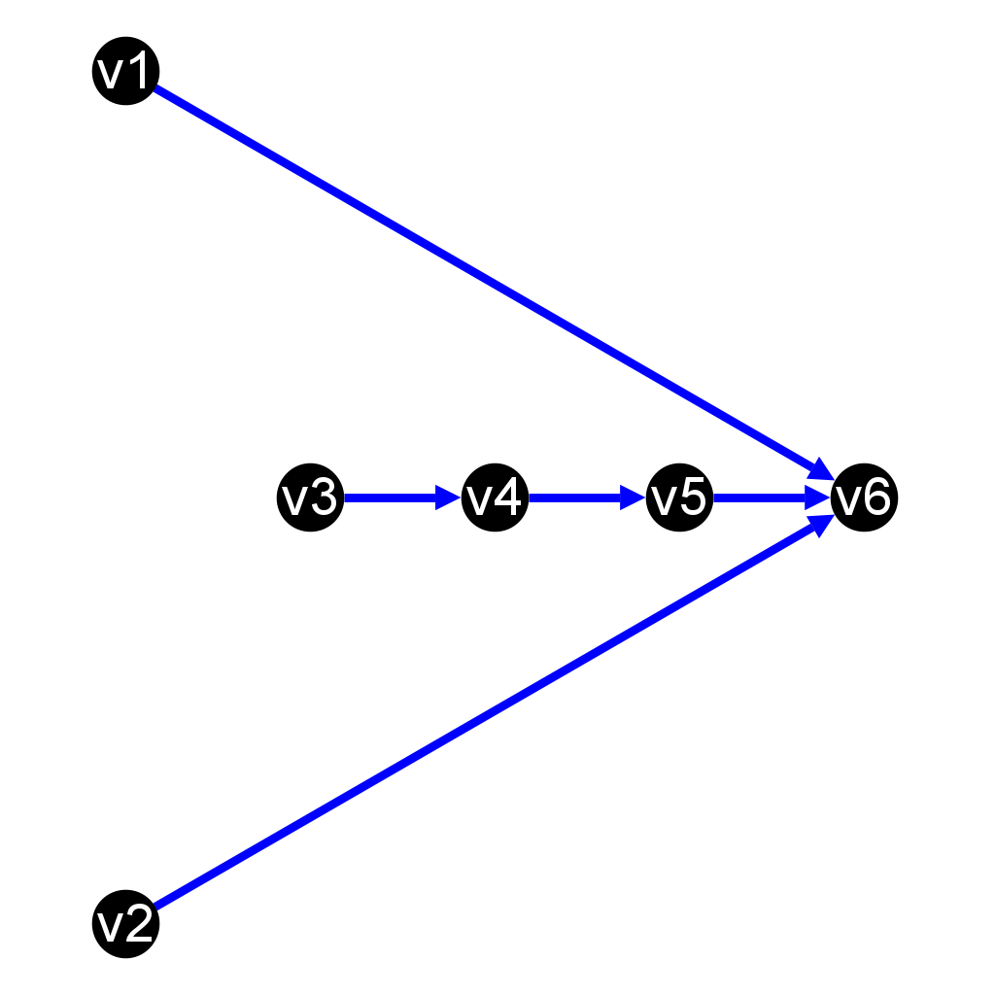
Calculating the edge weights
Let T₁ be a spanning tree directed out of v₁, and let T_{n} be a spanning tree rooted directed into v_{n}.
For every edge v_{i}v_{j}:
Find unique path from v₁ to v_{n} that travels along T₁, across v_{i}v_{j}, then along T_{n}.
Increment all edges along that path by 1.
T₁
T_{n}
Notes:
3-connected planar ⇔ convex polyhedron, 2-connected = biconnected Arbitrary planar graph drawing: add edges till 3-connected,use Tutte, then remove those edges

Slide 9
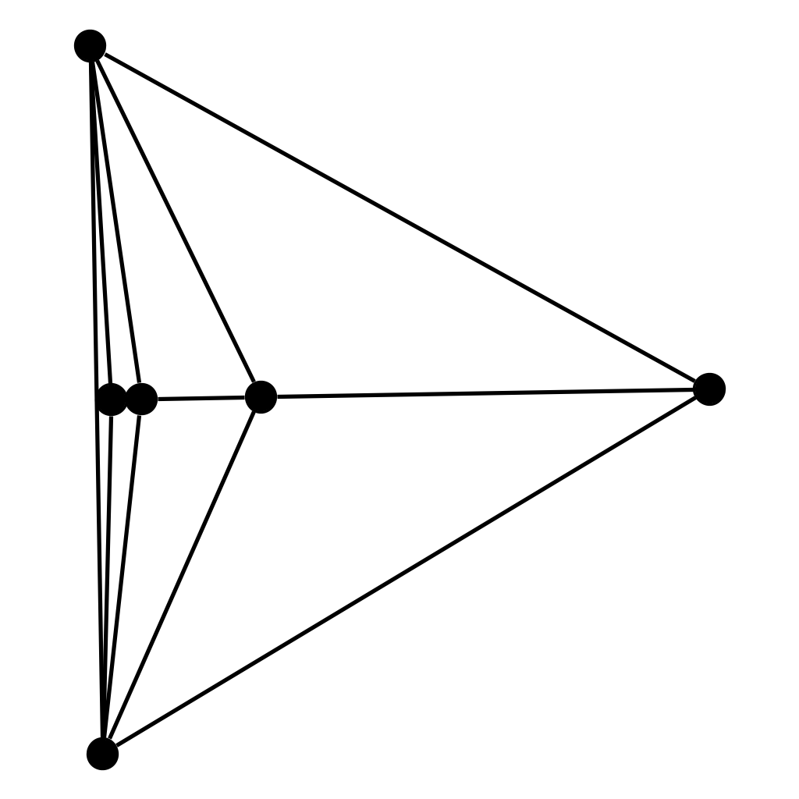
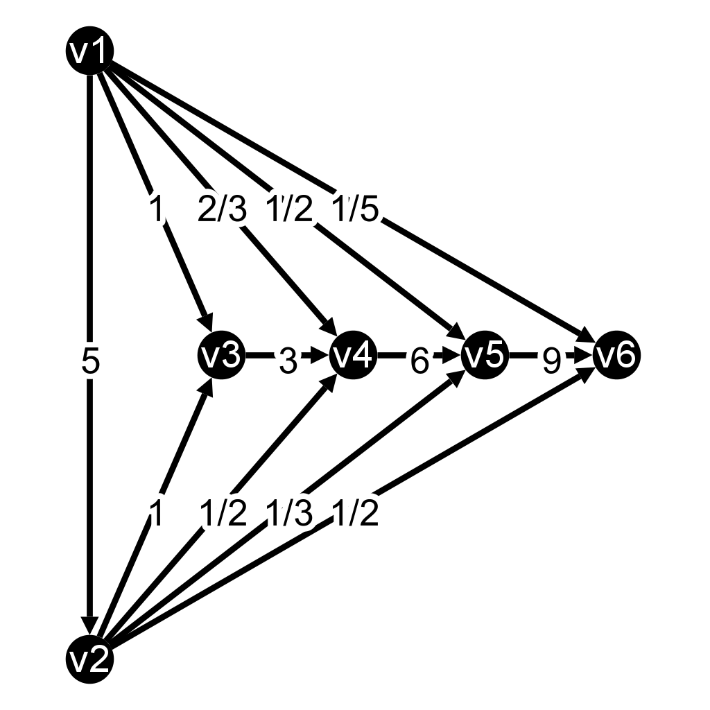
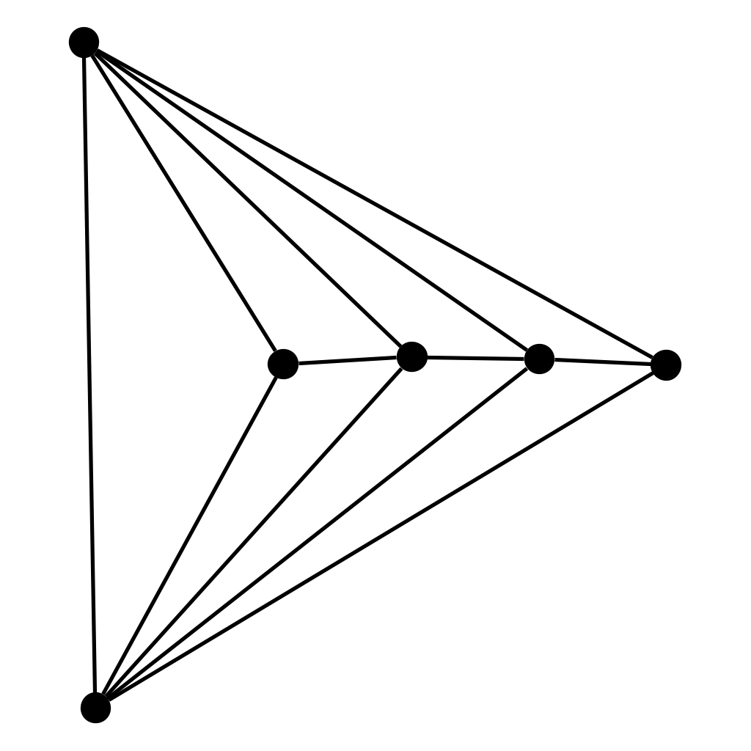
Spreading in the x-direction
Our new edge weights for v_{i}v_{j} will now be n_{ij} / (j-i).
Scaling by (j-i) adjusts according to the difference in x-rank between v_{i} and v_{j}.
Calculation of n_{ij} can be done in linear time via a backtracking argument.
Tutte
x-morph
Notes:
3-connected planar ⇔ convex polyhedron, 2-connected = biconnected Arbitrary planar graph drawing: add edges till 3-connected,use Tutte, then remove those edges

Slide 10
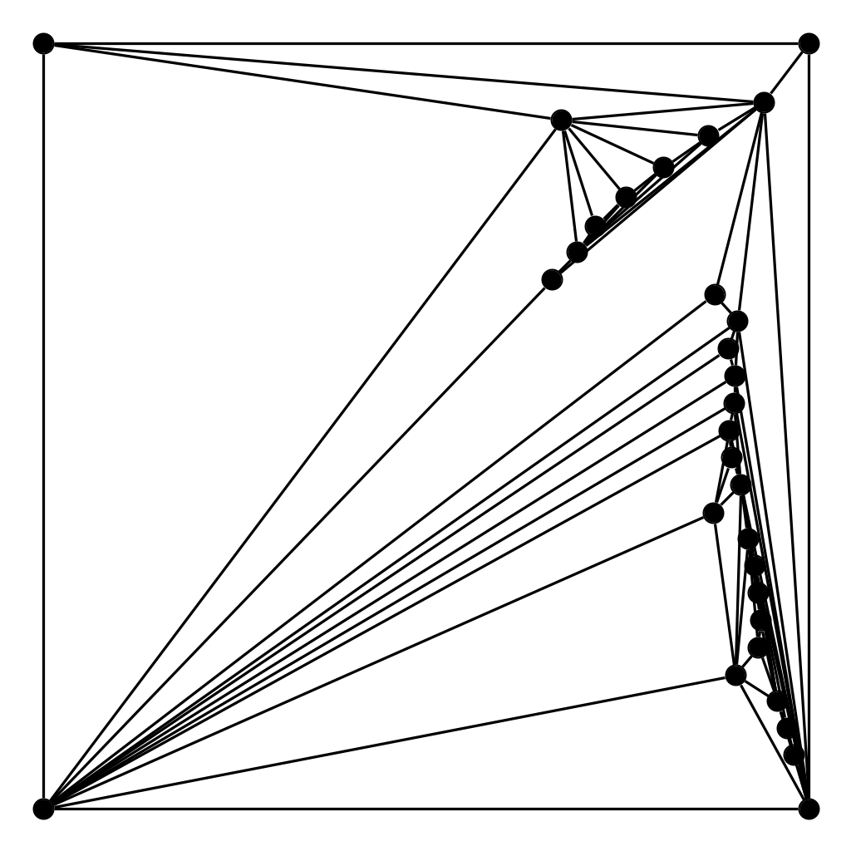
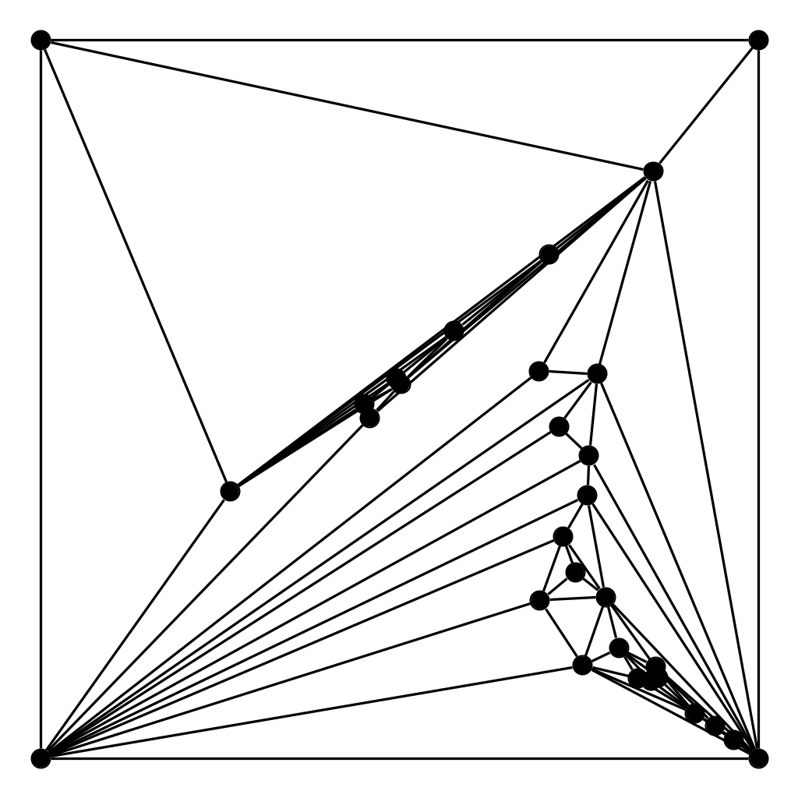
It’s Morphin’ Time
Can spread a drawing in any direction via rotating it, spreading in the x-direction, then rotating it back.
[99 Floater, Gotsman] Taking convex combinations of the edge weights between two weighted Tutte drawings with identical outer face will produce a smooth morph between them.
Tutte for G(30,80)
x-spread
y-spread
xy-morph

Slide 11
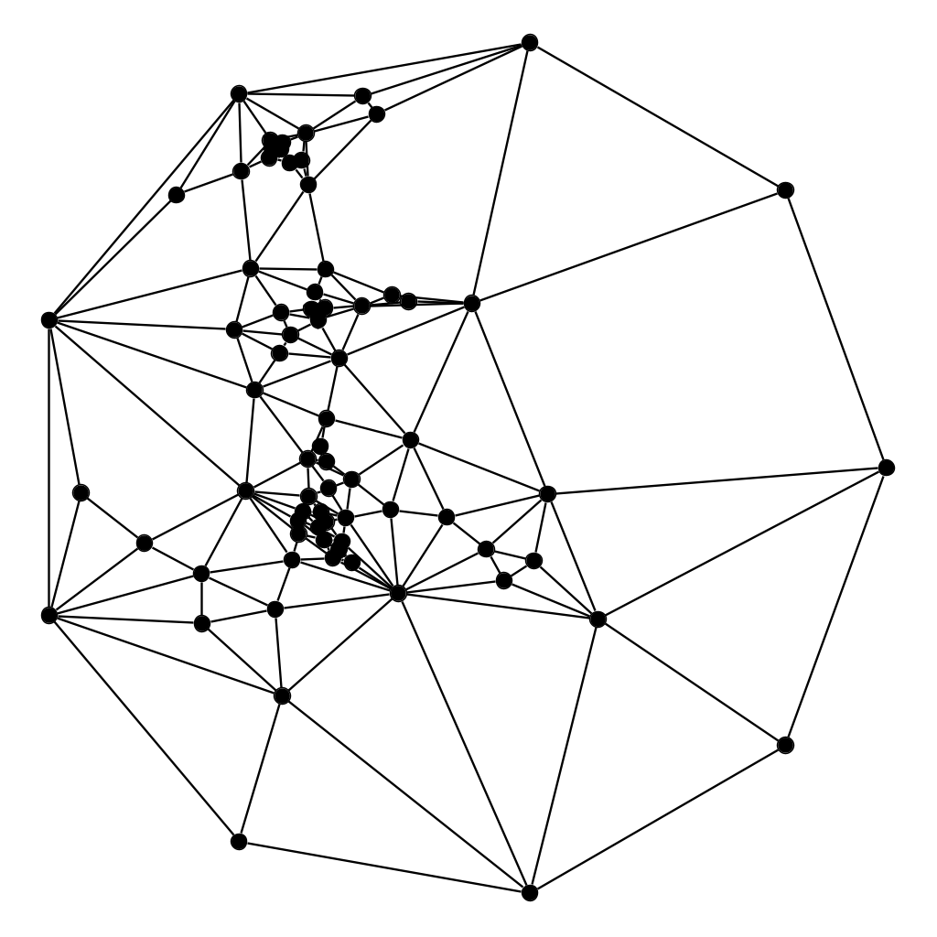
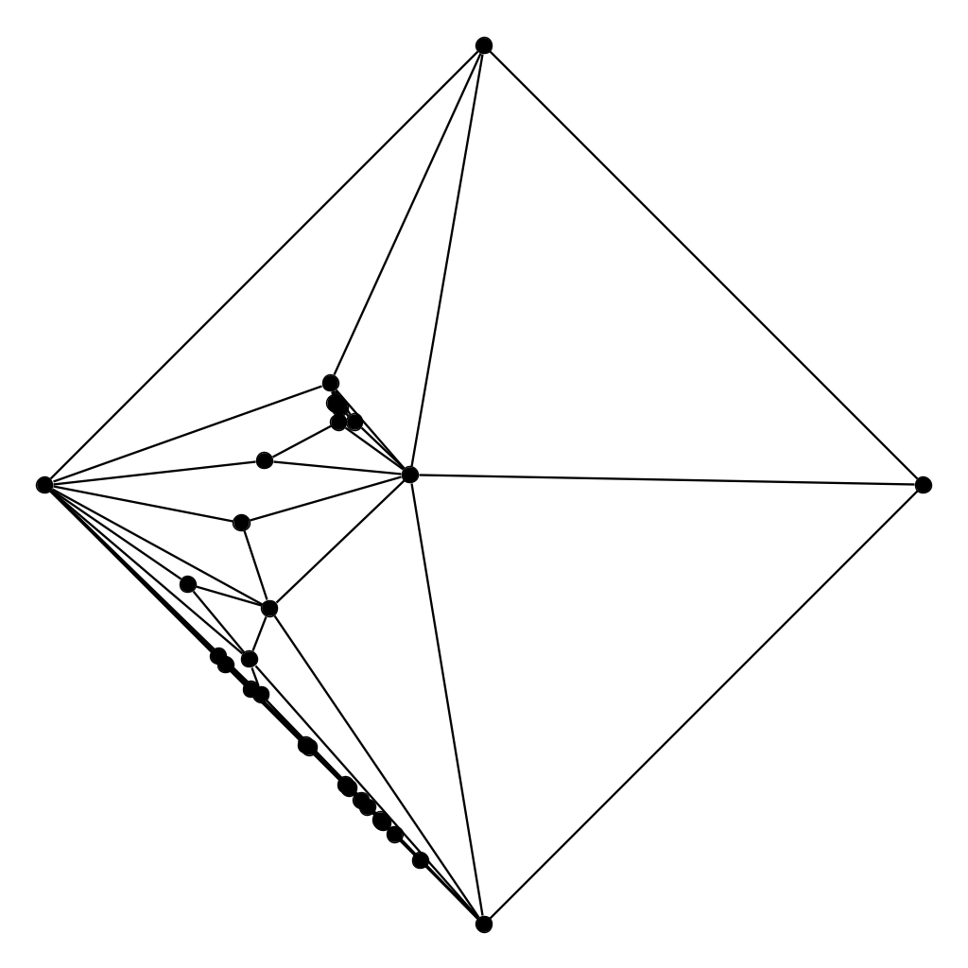
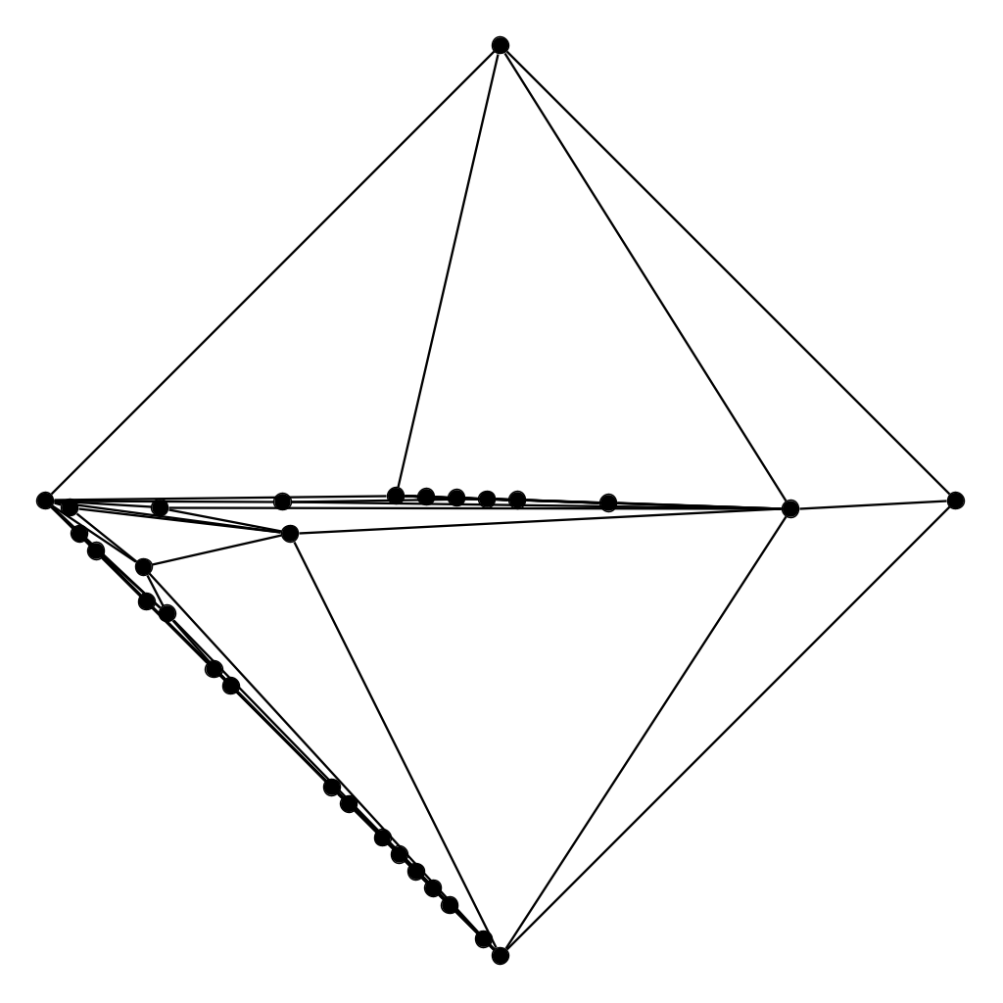
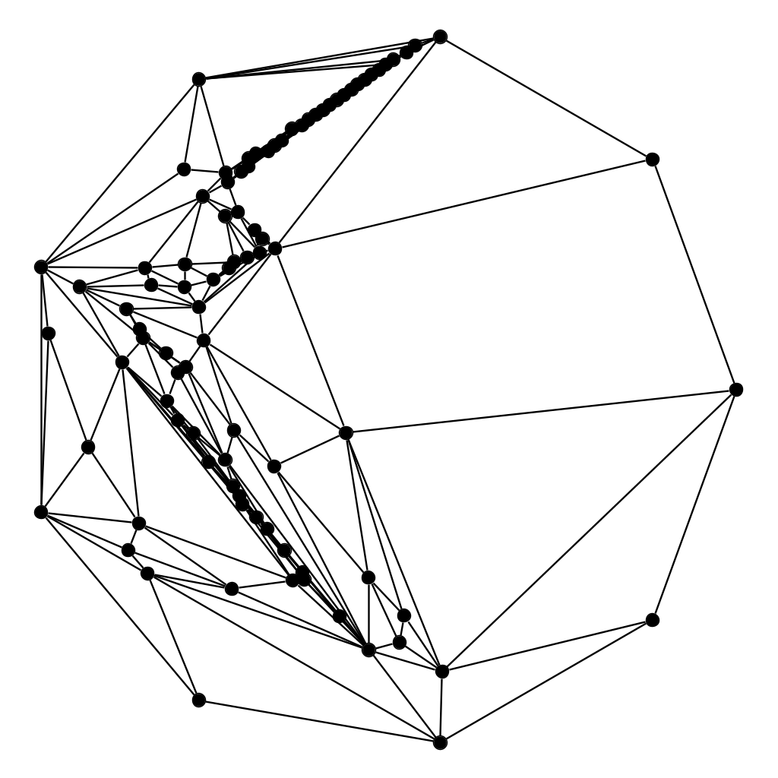
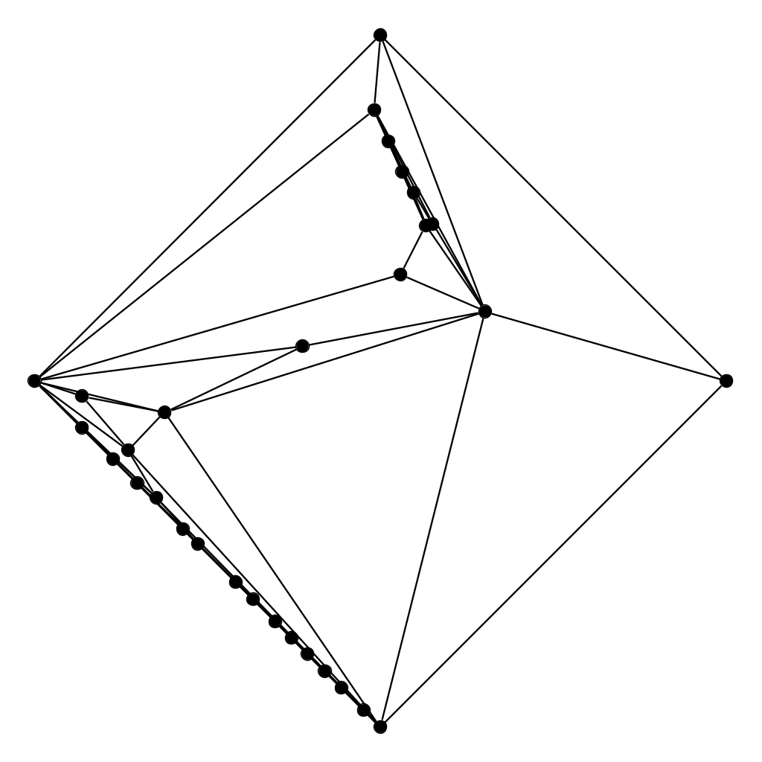
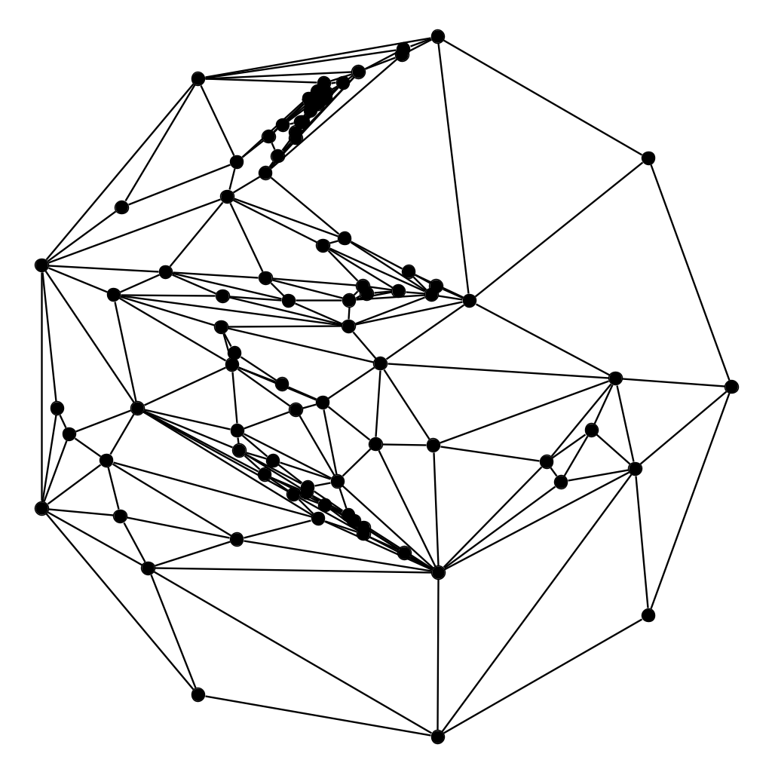
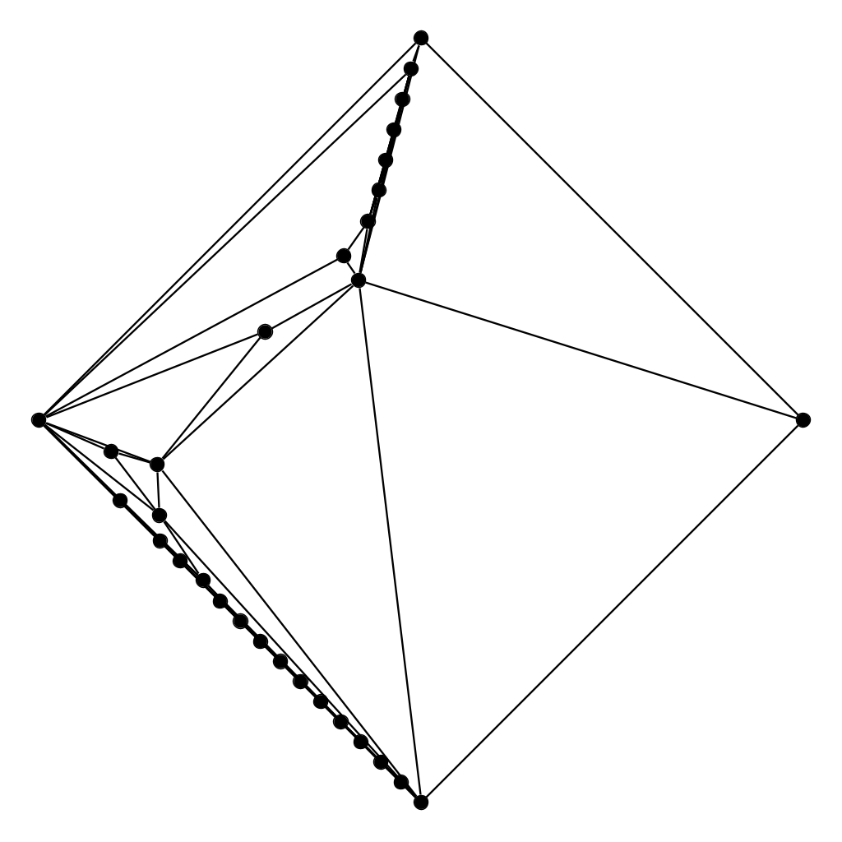
Rotating may help!
We want to spread the drawing in two orthogonal directions and morph those two drawings.
Tutte for G(30,80)
x-spread
y-spread
xy-morph
xy-morph
Notes:
3-connected planar ⇔ convex polyhedron, 2-connected = biconnected Arbitrary planar graph drawing: add edges till 3-connected,use Tutte, then remove those edges

Slide 12
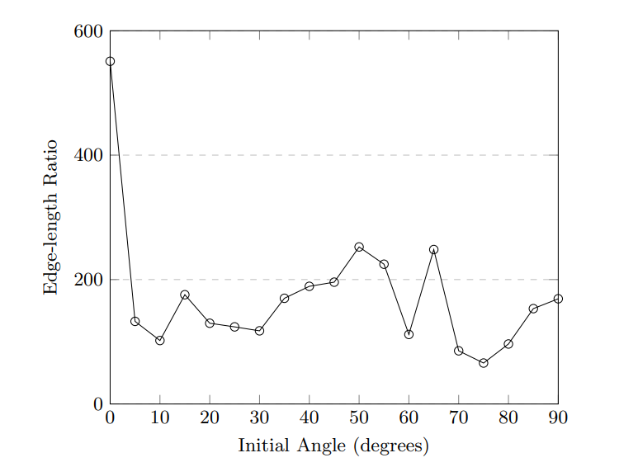
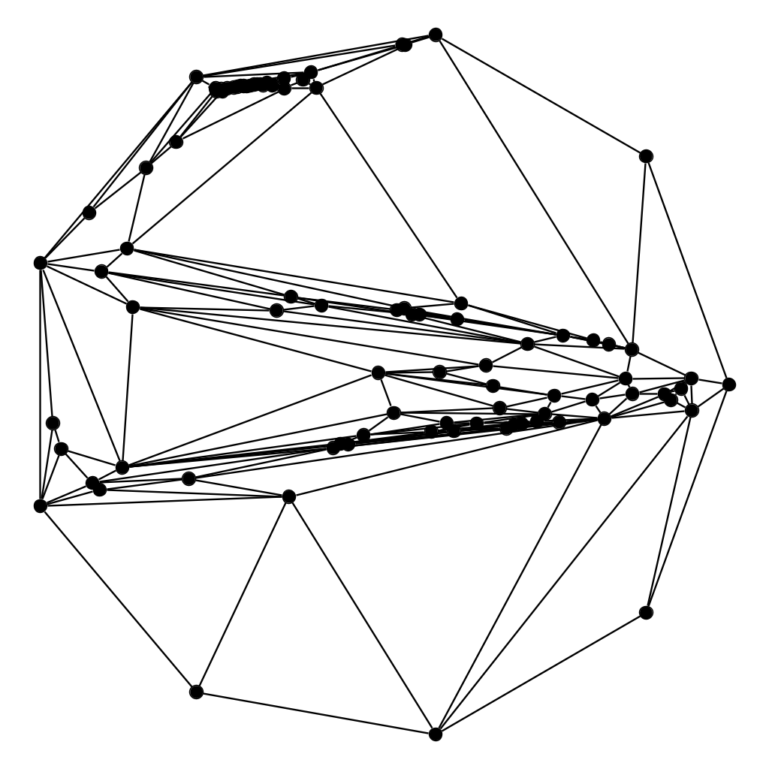
Kaleidoscope
G(90,240)
0 degrees
Tutte
x-spread
y-spread
xy-morph

Slide 13
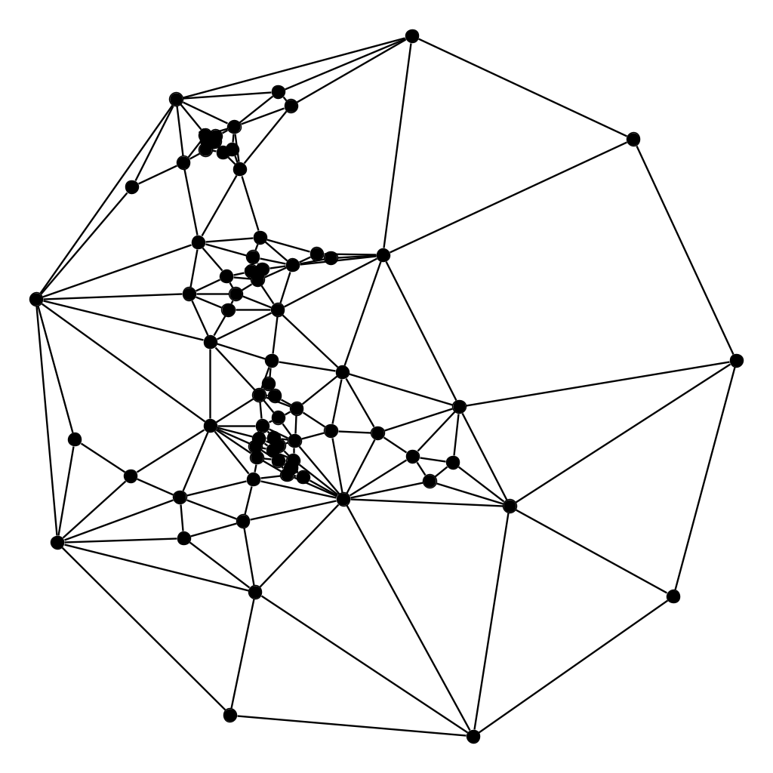
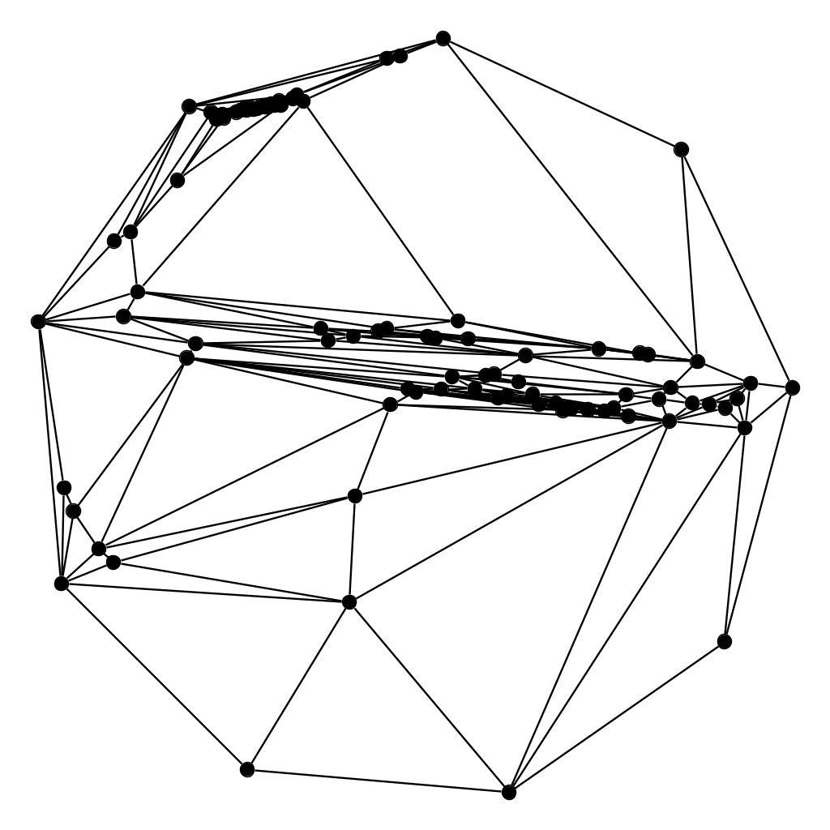
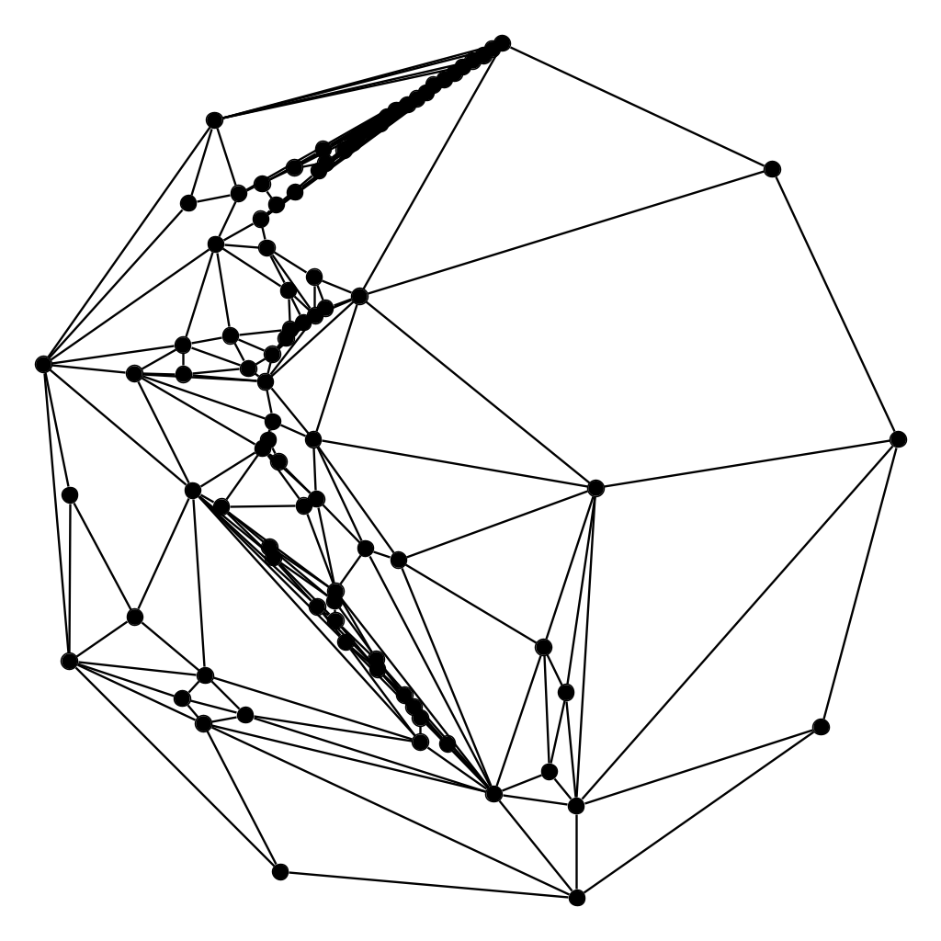
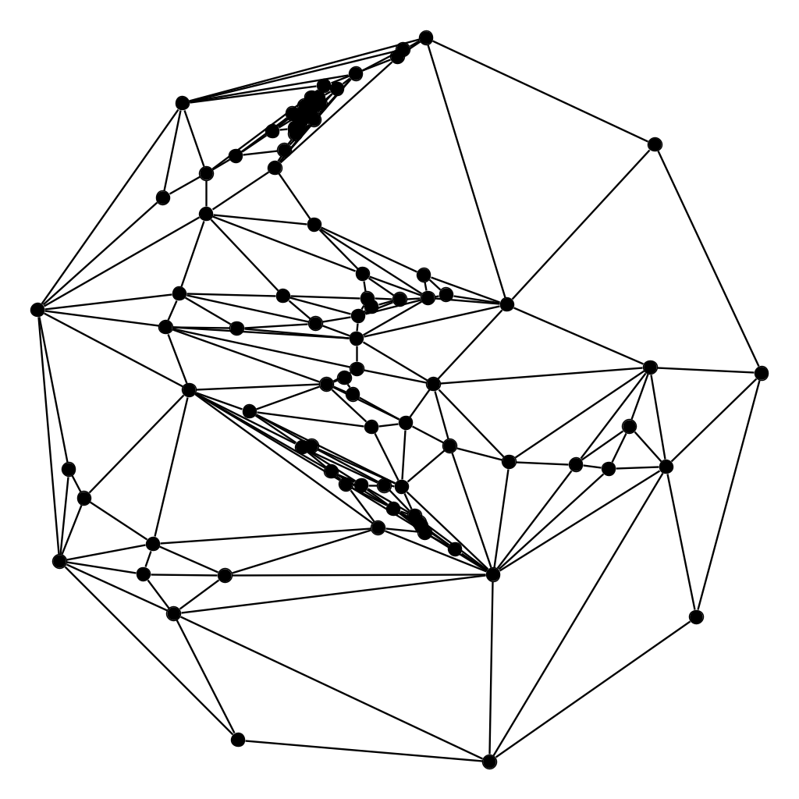
Kaleidoscope
G(90,240)
5 degrees
Tutte
x-spread
y-spread
xy-morph

Slide 14
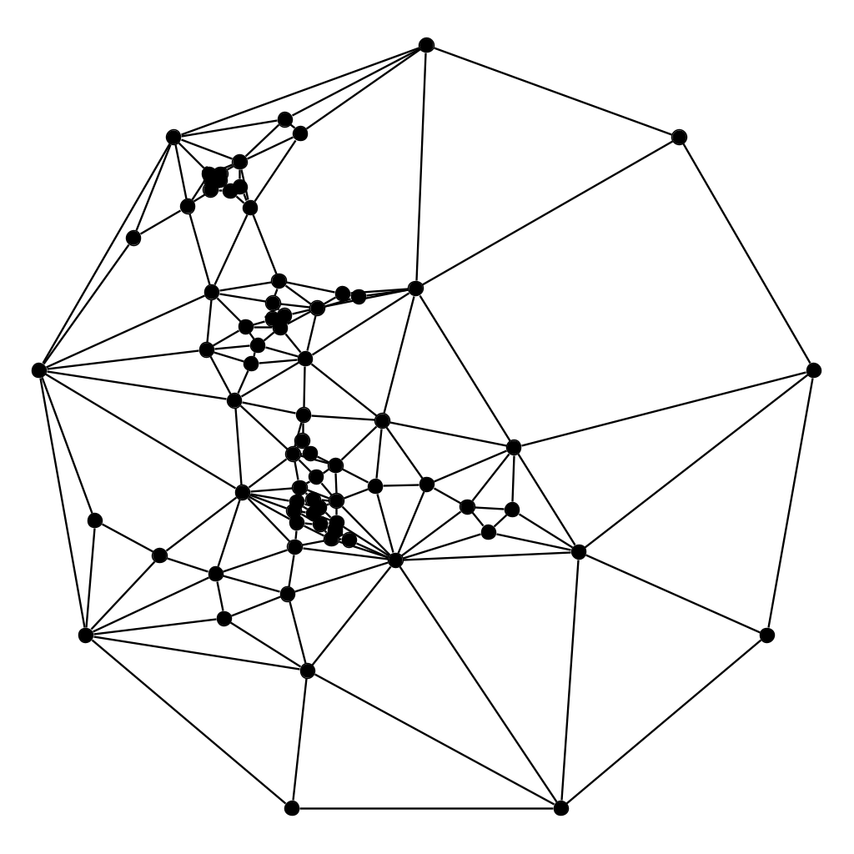
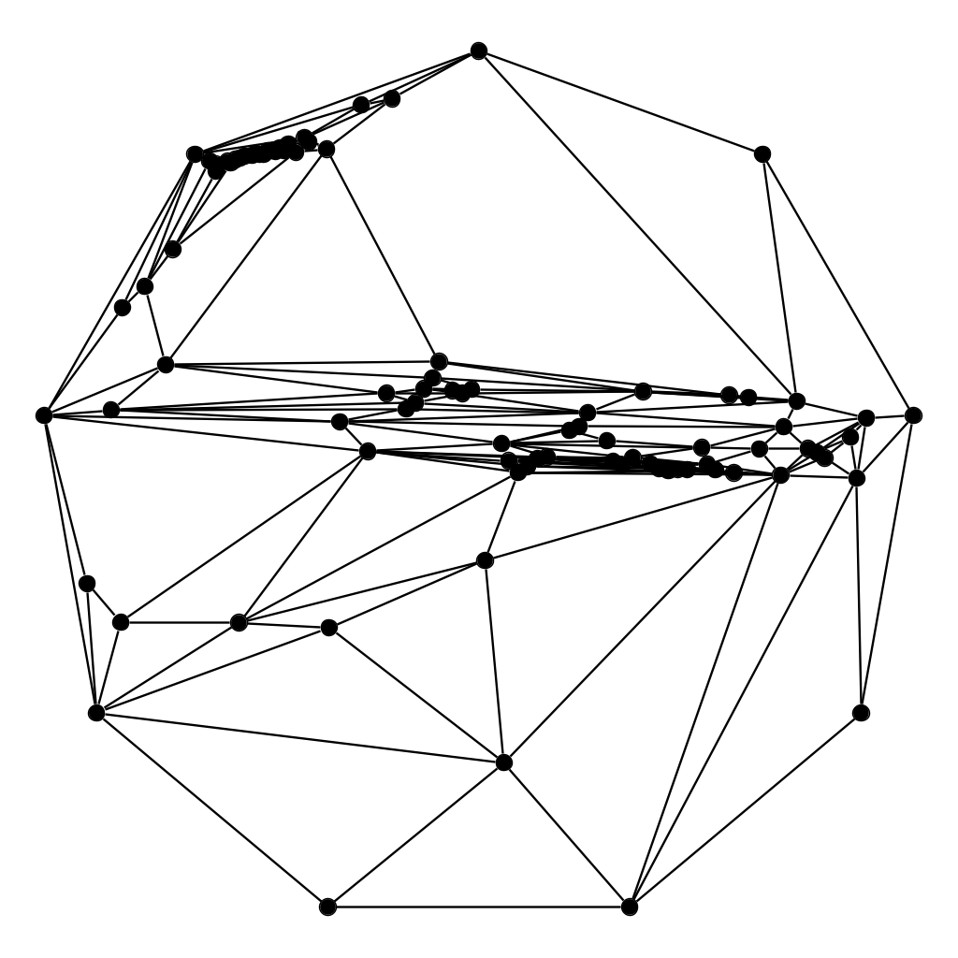
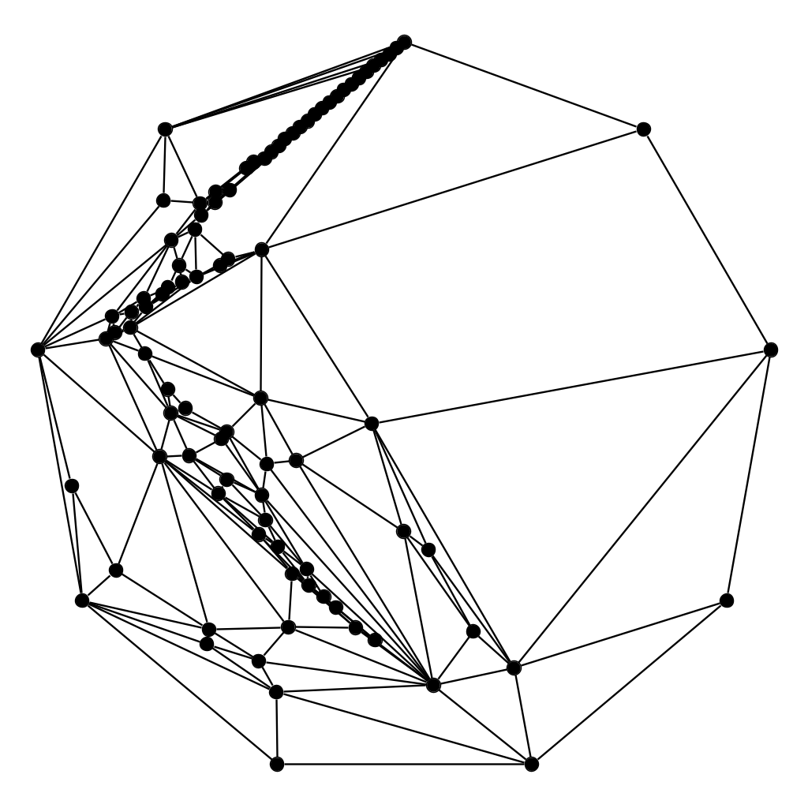
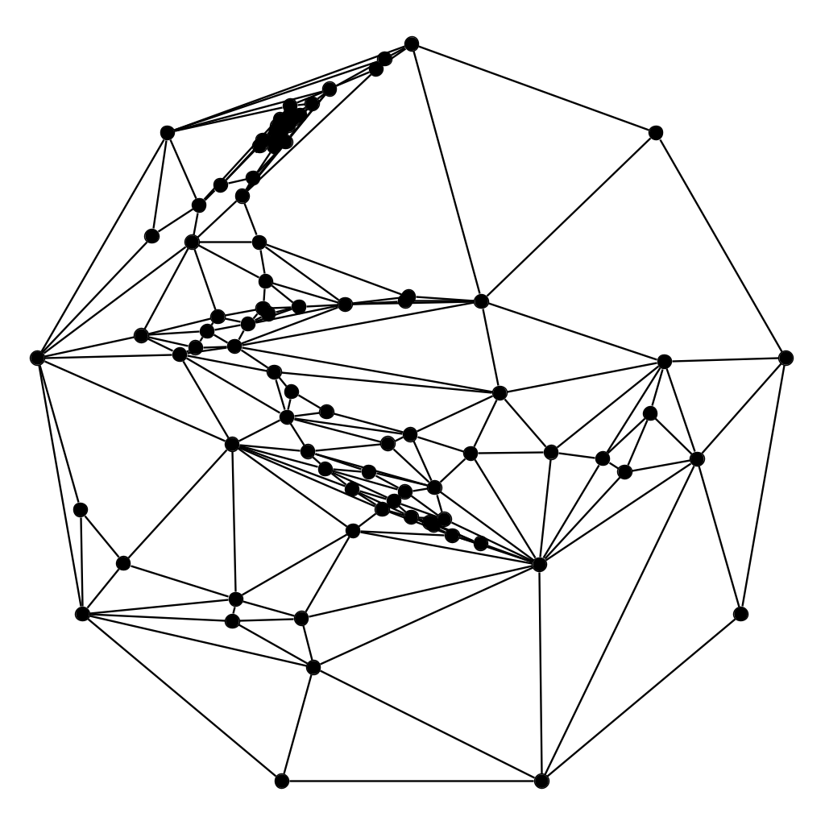
Kaleidoscope
G(90,240)
10 degrees
Tutte
x-spread
y-spread
xy-morph

Slide 15
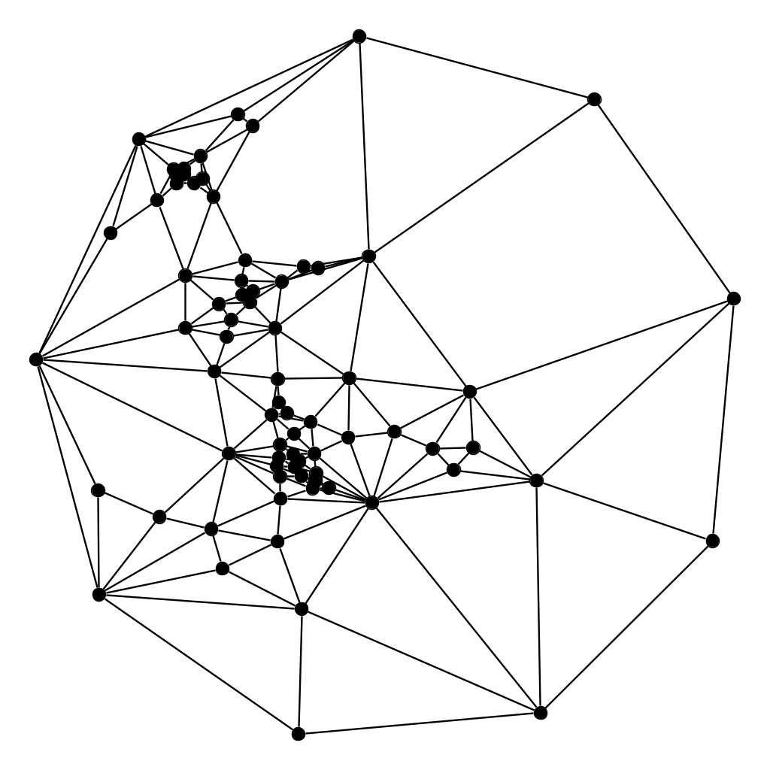
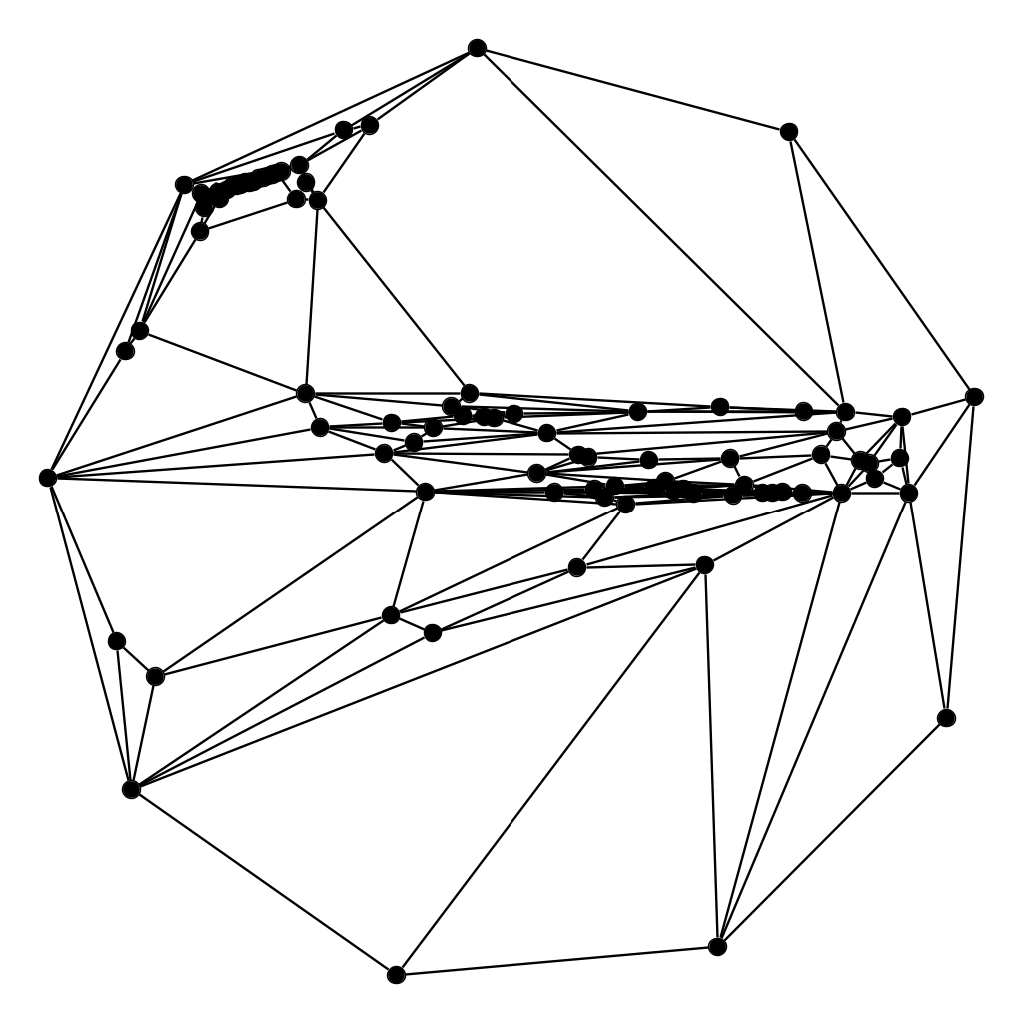
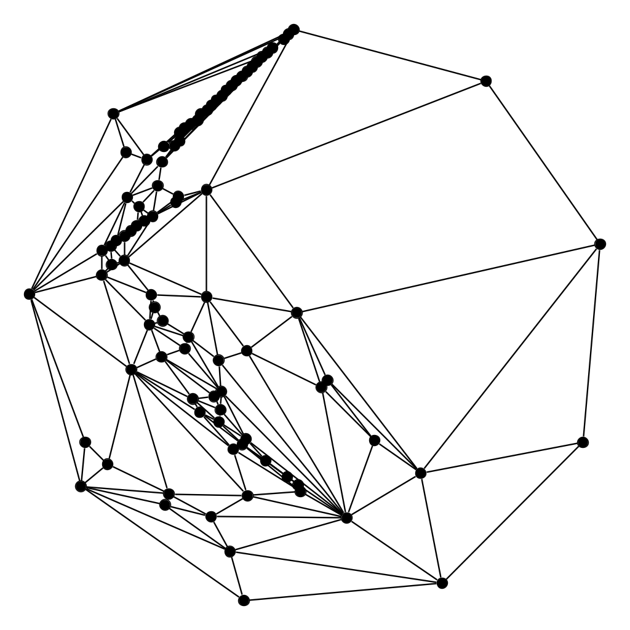
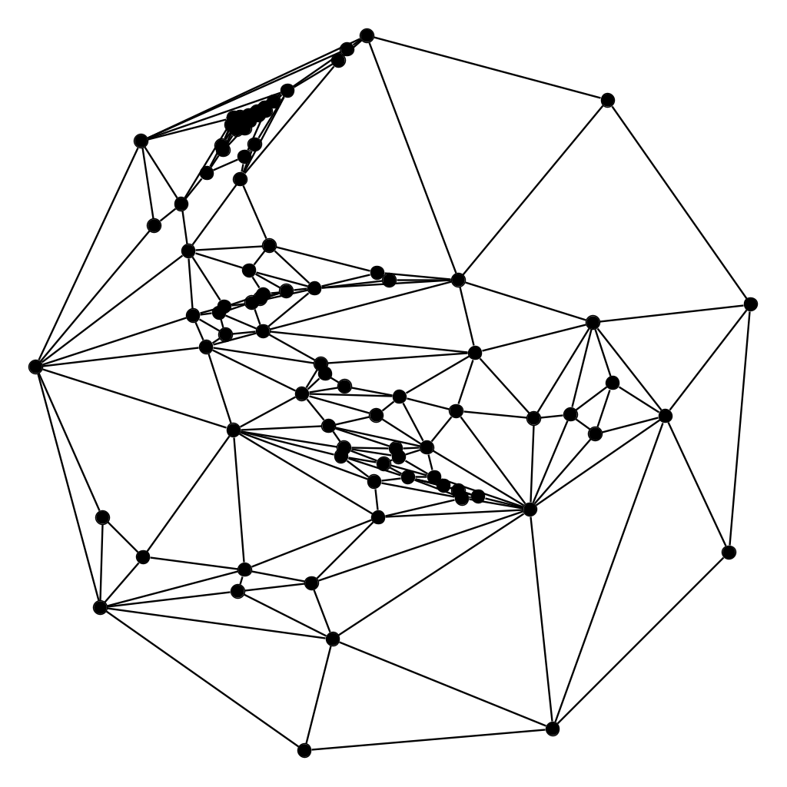
Kaleidoscope
G(90,240)
15 degrees
Tutte
x-spread
y-spread
xy-morph

Slide 16
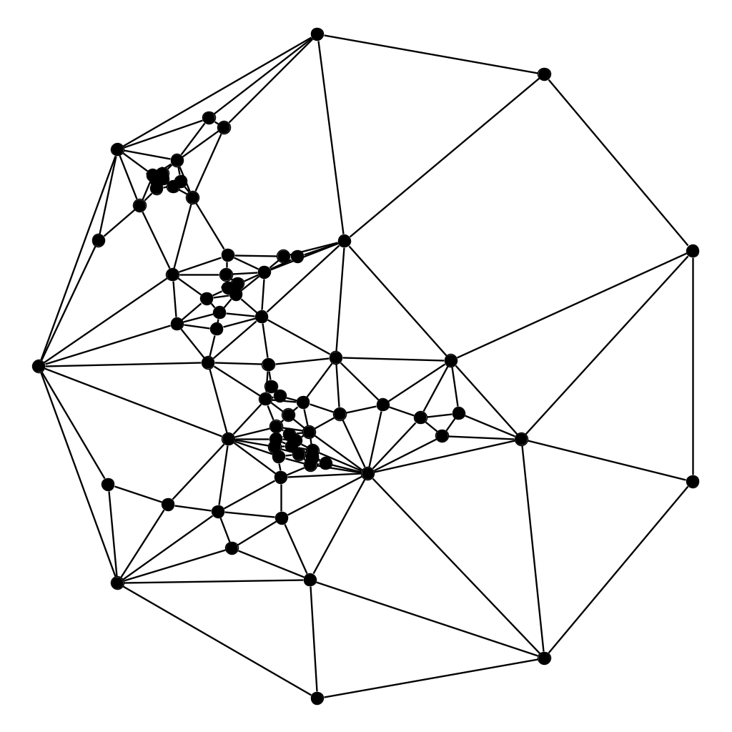
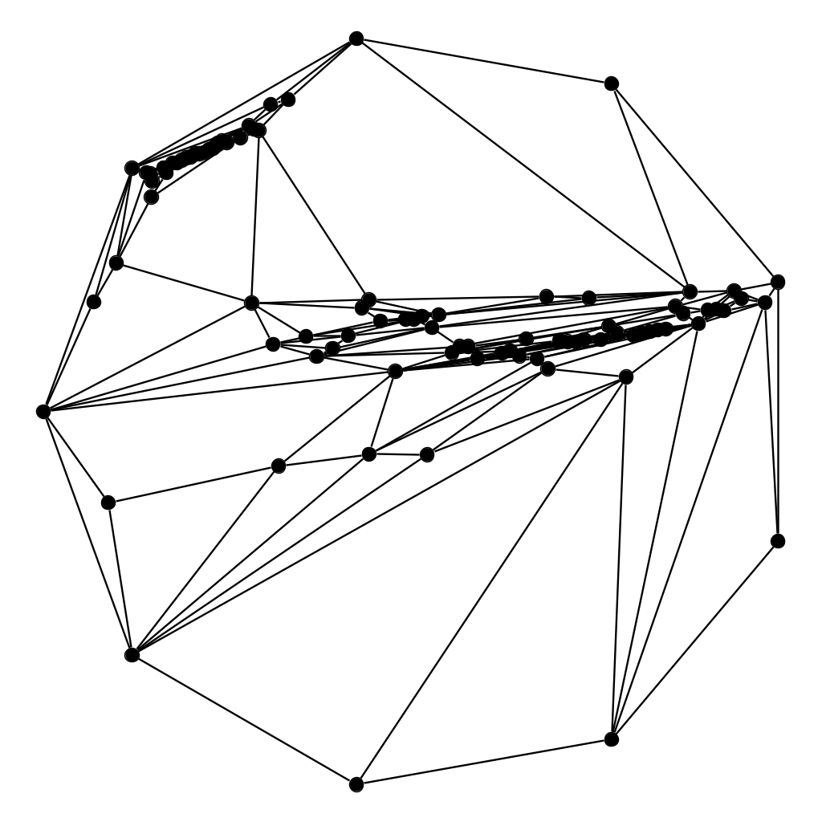
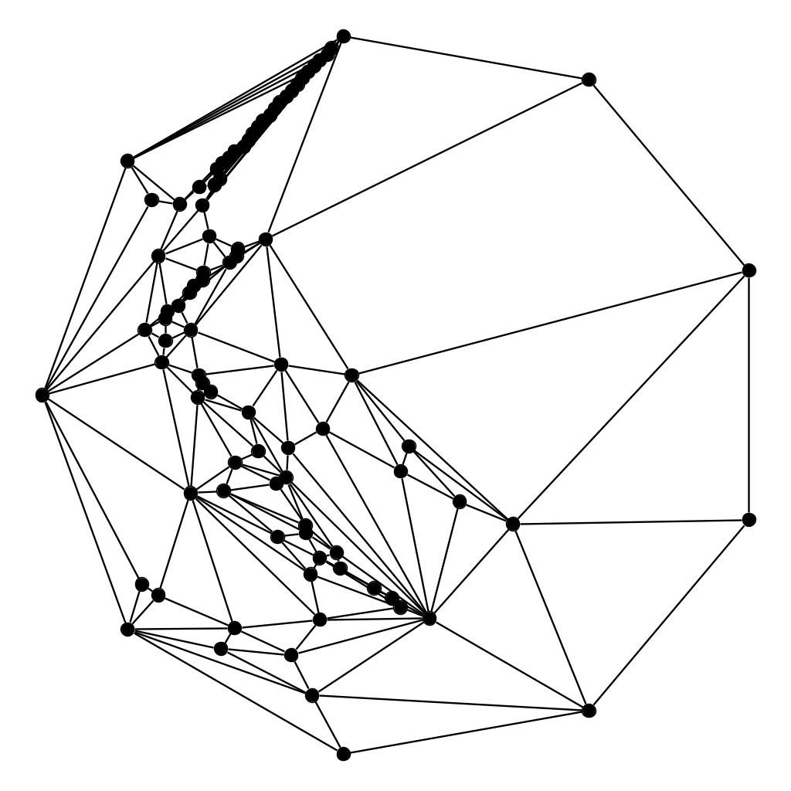
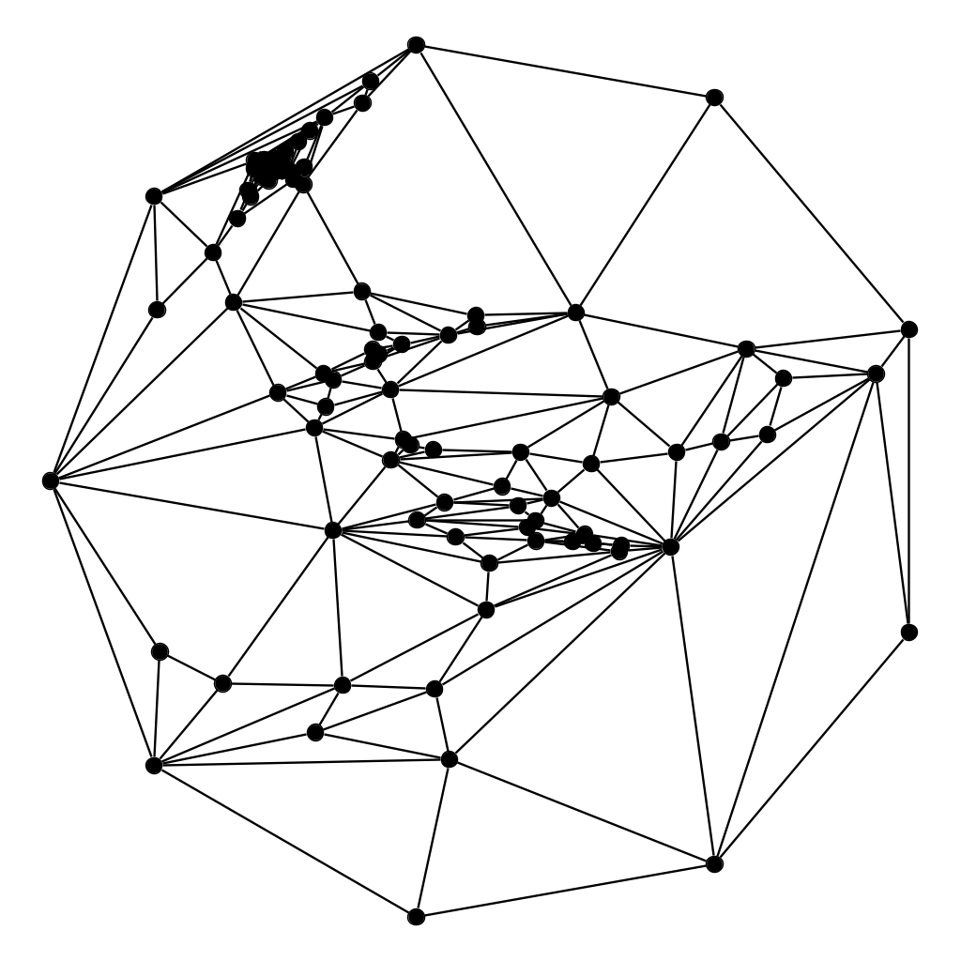
Kaleidoscope
G(90,240)
20 degrees
Tutte
x-spread
y-spread
xy-morph

Slide 17
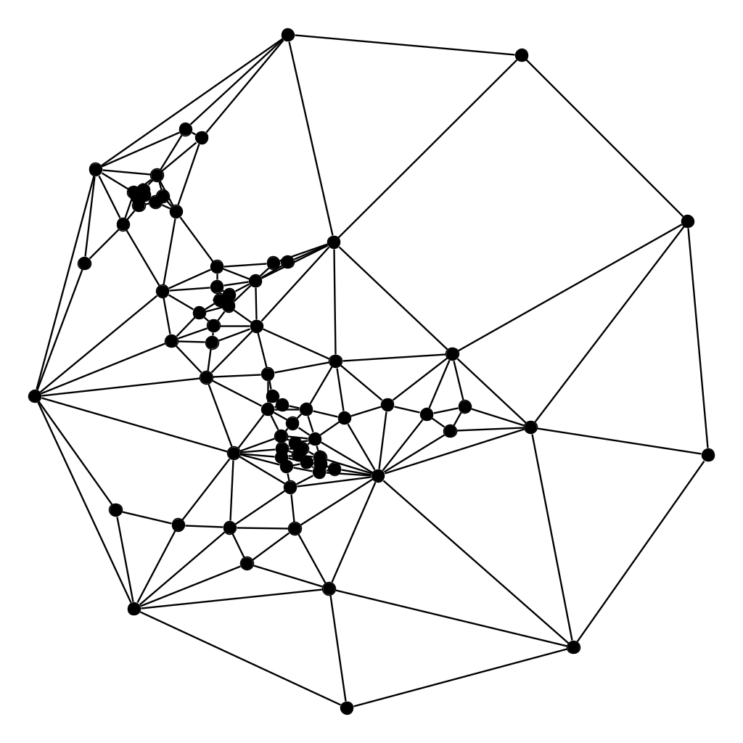
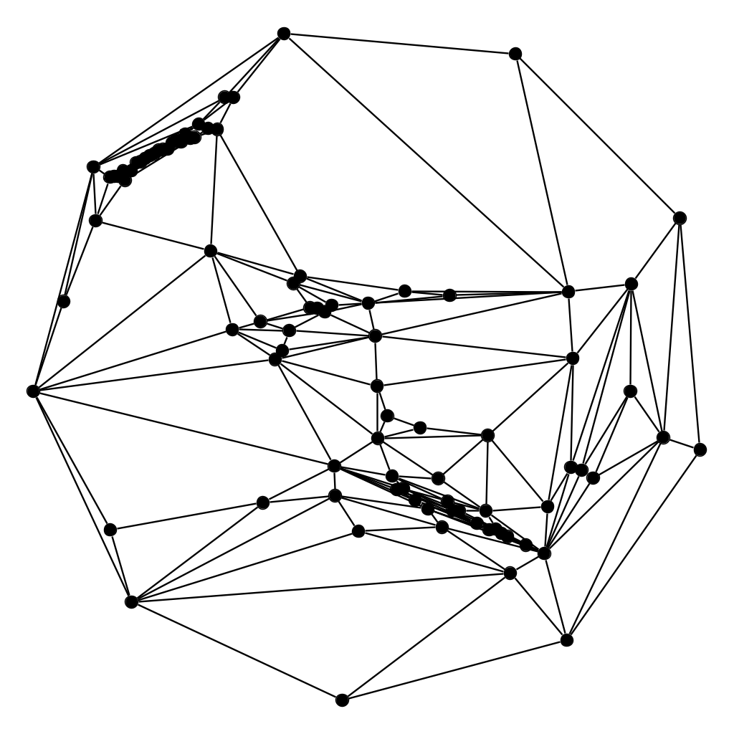
Kaleidoscope
G(90,240)
25 degrees
Tutte
x-spread
y-spread
xy-morph

Slide 18
Kaleidoscope
G(90,240)
30 degrees
Tutte
x-spread
y-spread
xy-morph

Slide 19
Kaleidoscope
G(90,240)
35 degrees
Tutte
x-spread
y-spread
xy-morph

Slide 20
Kaleidoscope
G(90,240)
40 degrees
Tutte
x-spread
y-spread
xy-morph

Slide 21
Kaleidoscope
G(90,240)
45 degrees
Tutte
x-spread
y-spread
xy-morph

Slide 22
Kaleidoscope
G(90,240)
50 degrees
Tutte
x-spread
y-spread
xy-morph

Slide 23
Kaleidoscope
G(90,240)
55 degrees
Tutte
x-spread
y-spread
xy-morph

Slide 24
Kaleidoscope
G(90,240)
60 degrees
Tutte
x-spread
y-spread
xy-morph

Slide 25
Kaleidoscope
G(90,240)
65 degrees
Tutte
x-spread
y-spread
xy-morph

Slide 26
Kaleidoscope
G(90,240)
70 degrees
Tutte
x-spread
y-spread
xy-morph

Slide 27
Kaleidoscope
G(90,240)
75 degrees
Tutte
x-spread
y-spread
xy-morph

Slide 28
Kaleidoscope
G(90,240)
80 degrees
Tutte
x-spread
y-spread
xy-morph

Slide 29
Kaleidoscope
G(90,240)
85 degrees
Tutte
x-spread
y-spread
xy-morph

Slide 30
Kaleidoscope
G(90,240)
90 degrees
Tutte
x-spread
y-spread
xy-morph

Slide 31
Conclusion
Spreading internal vertices towards the outer face reduces the edge-length ratio marginally but preserves the general structure.
Spreading the internal vertices in the x-direction or y-direction yields a low edge-length ratio near the number of vertices, but many vertices are often clustered onto a line.
The corresponding xy-morph has higher edge-length ratio, but results in more pleasing drawings.
Notes:
3-connected planar ⇔ convex polyhedron, 2-connected = biconnected Arbitrary planar graph drawing: add edges till 3-connected,use Tutte, then remove those edges

